Slide 1
Rwanda Special Needs Camp Meeting
August 13 – 18, 2018
Larry R Evans, DMin.
Asst. to the President
Special Needs Ministries
General Conference of SDA

Slide 2
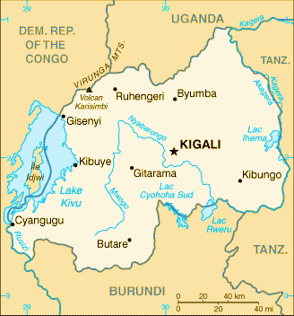
Rwanda EAST CENTRAL AFRICA DIVISION

Slide 3
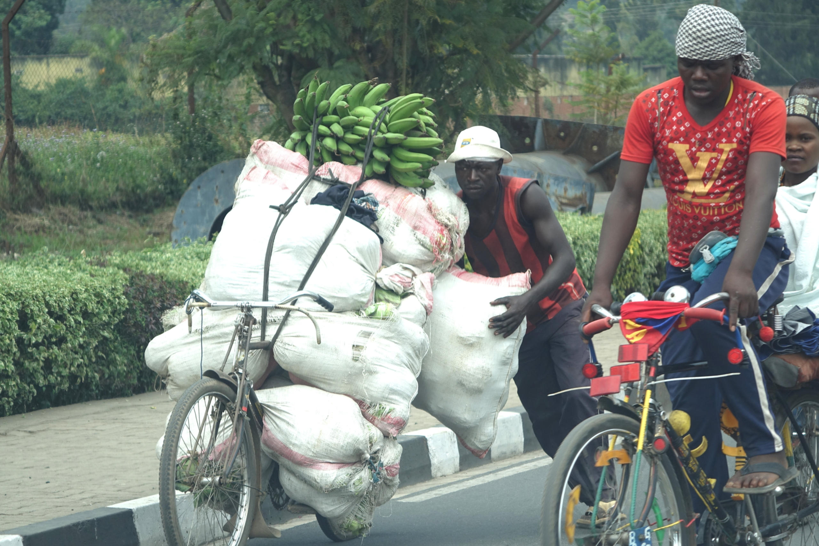
A common sight - amazing loads carried on bikes

Slide 4
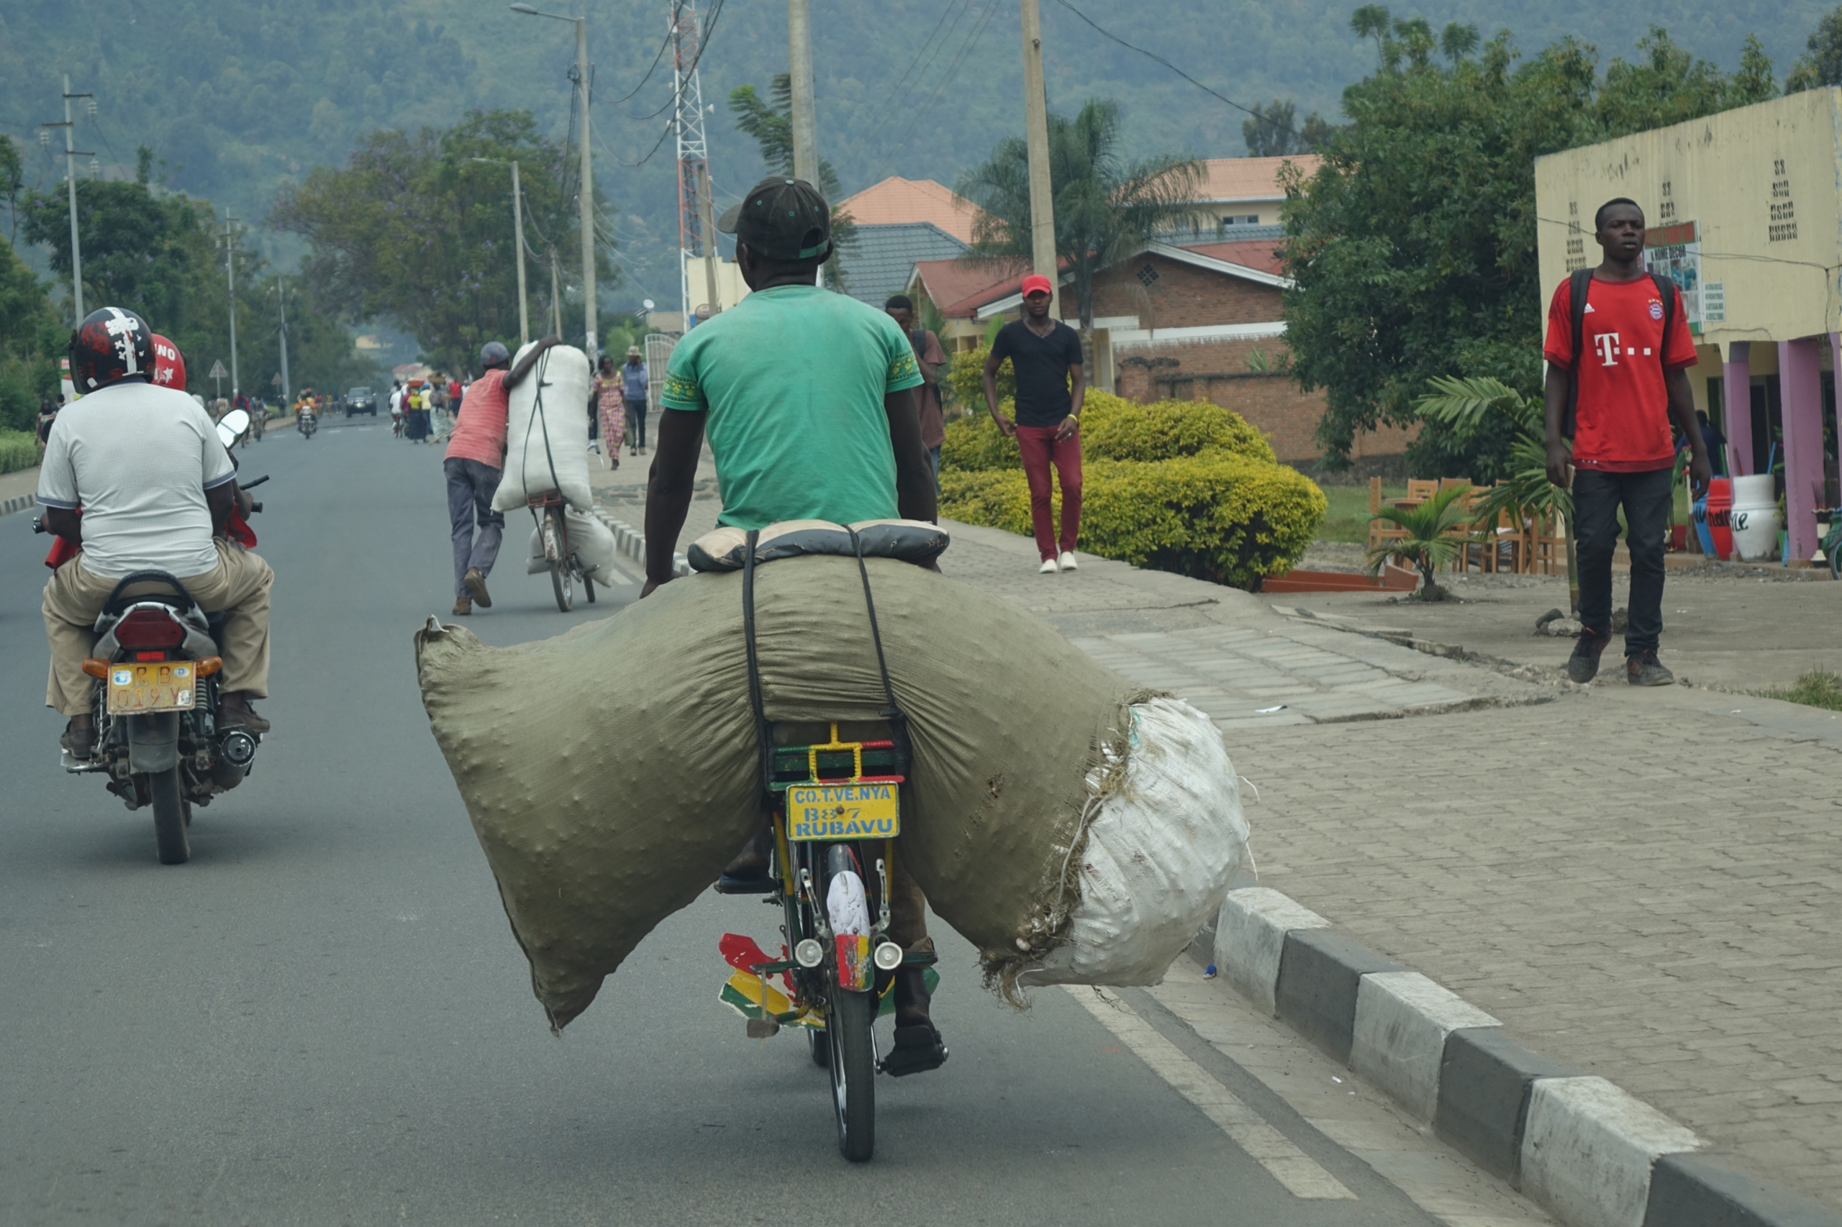

Slide 5
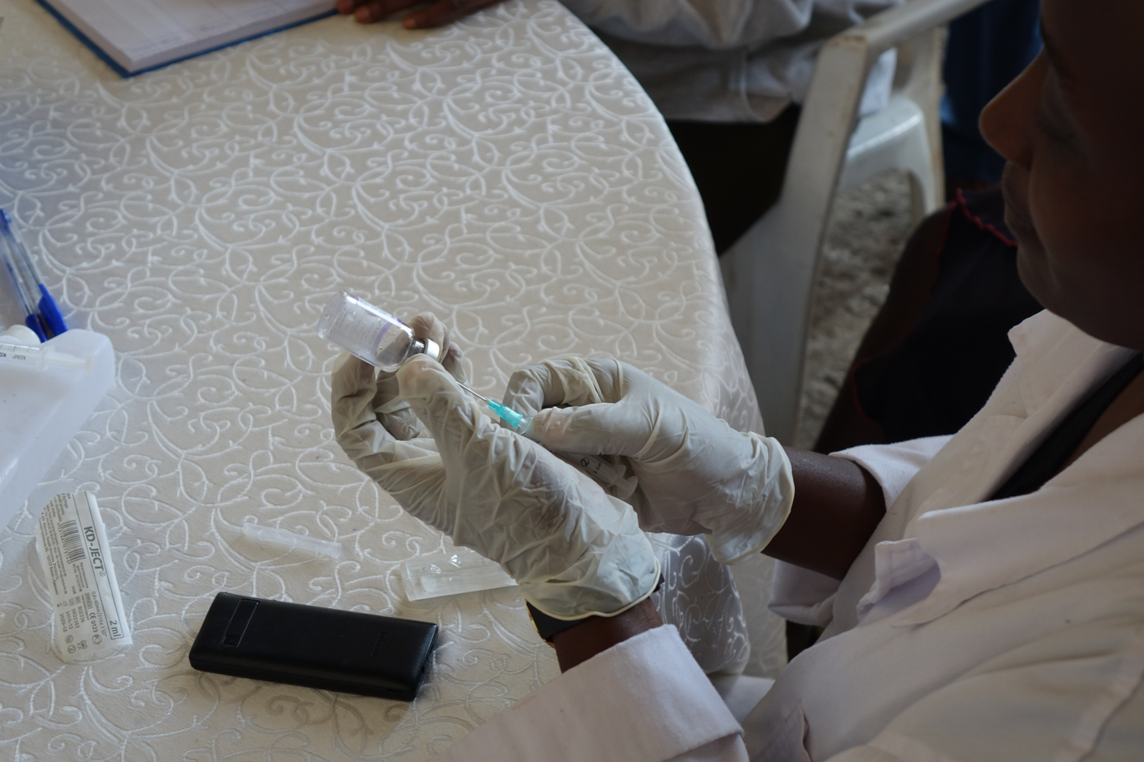
Government offered free vaccinations during the Special Needs Camp Meeting.

Slide 6
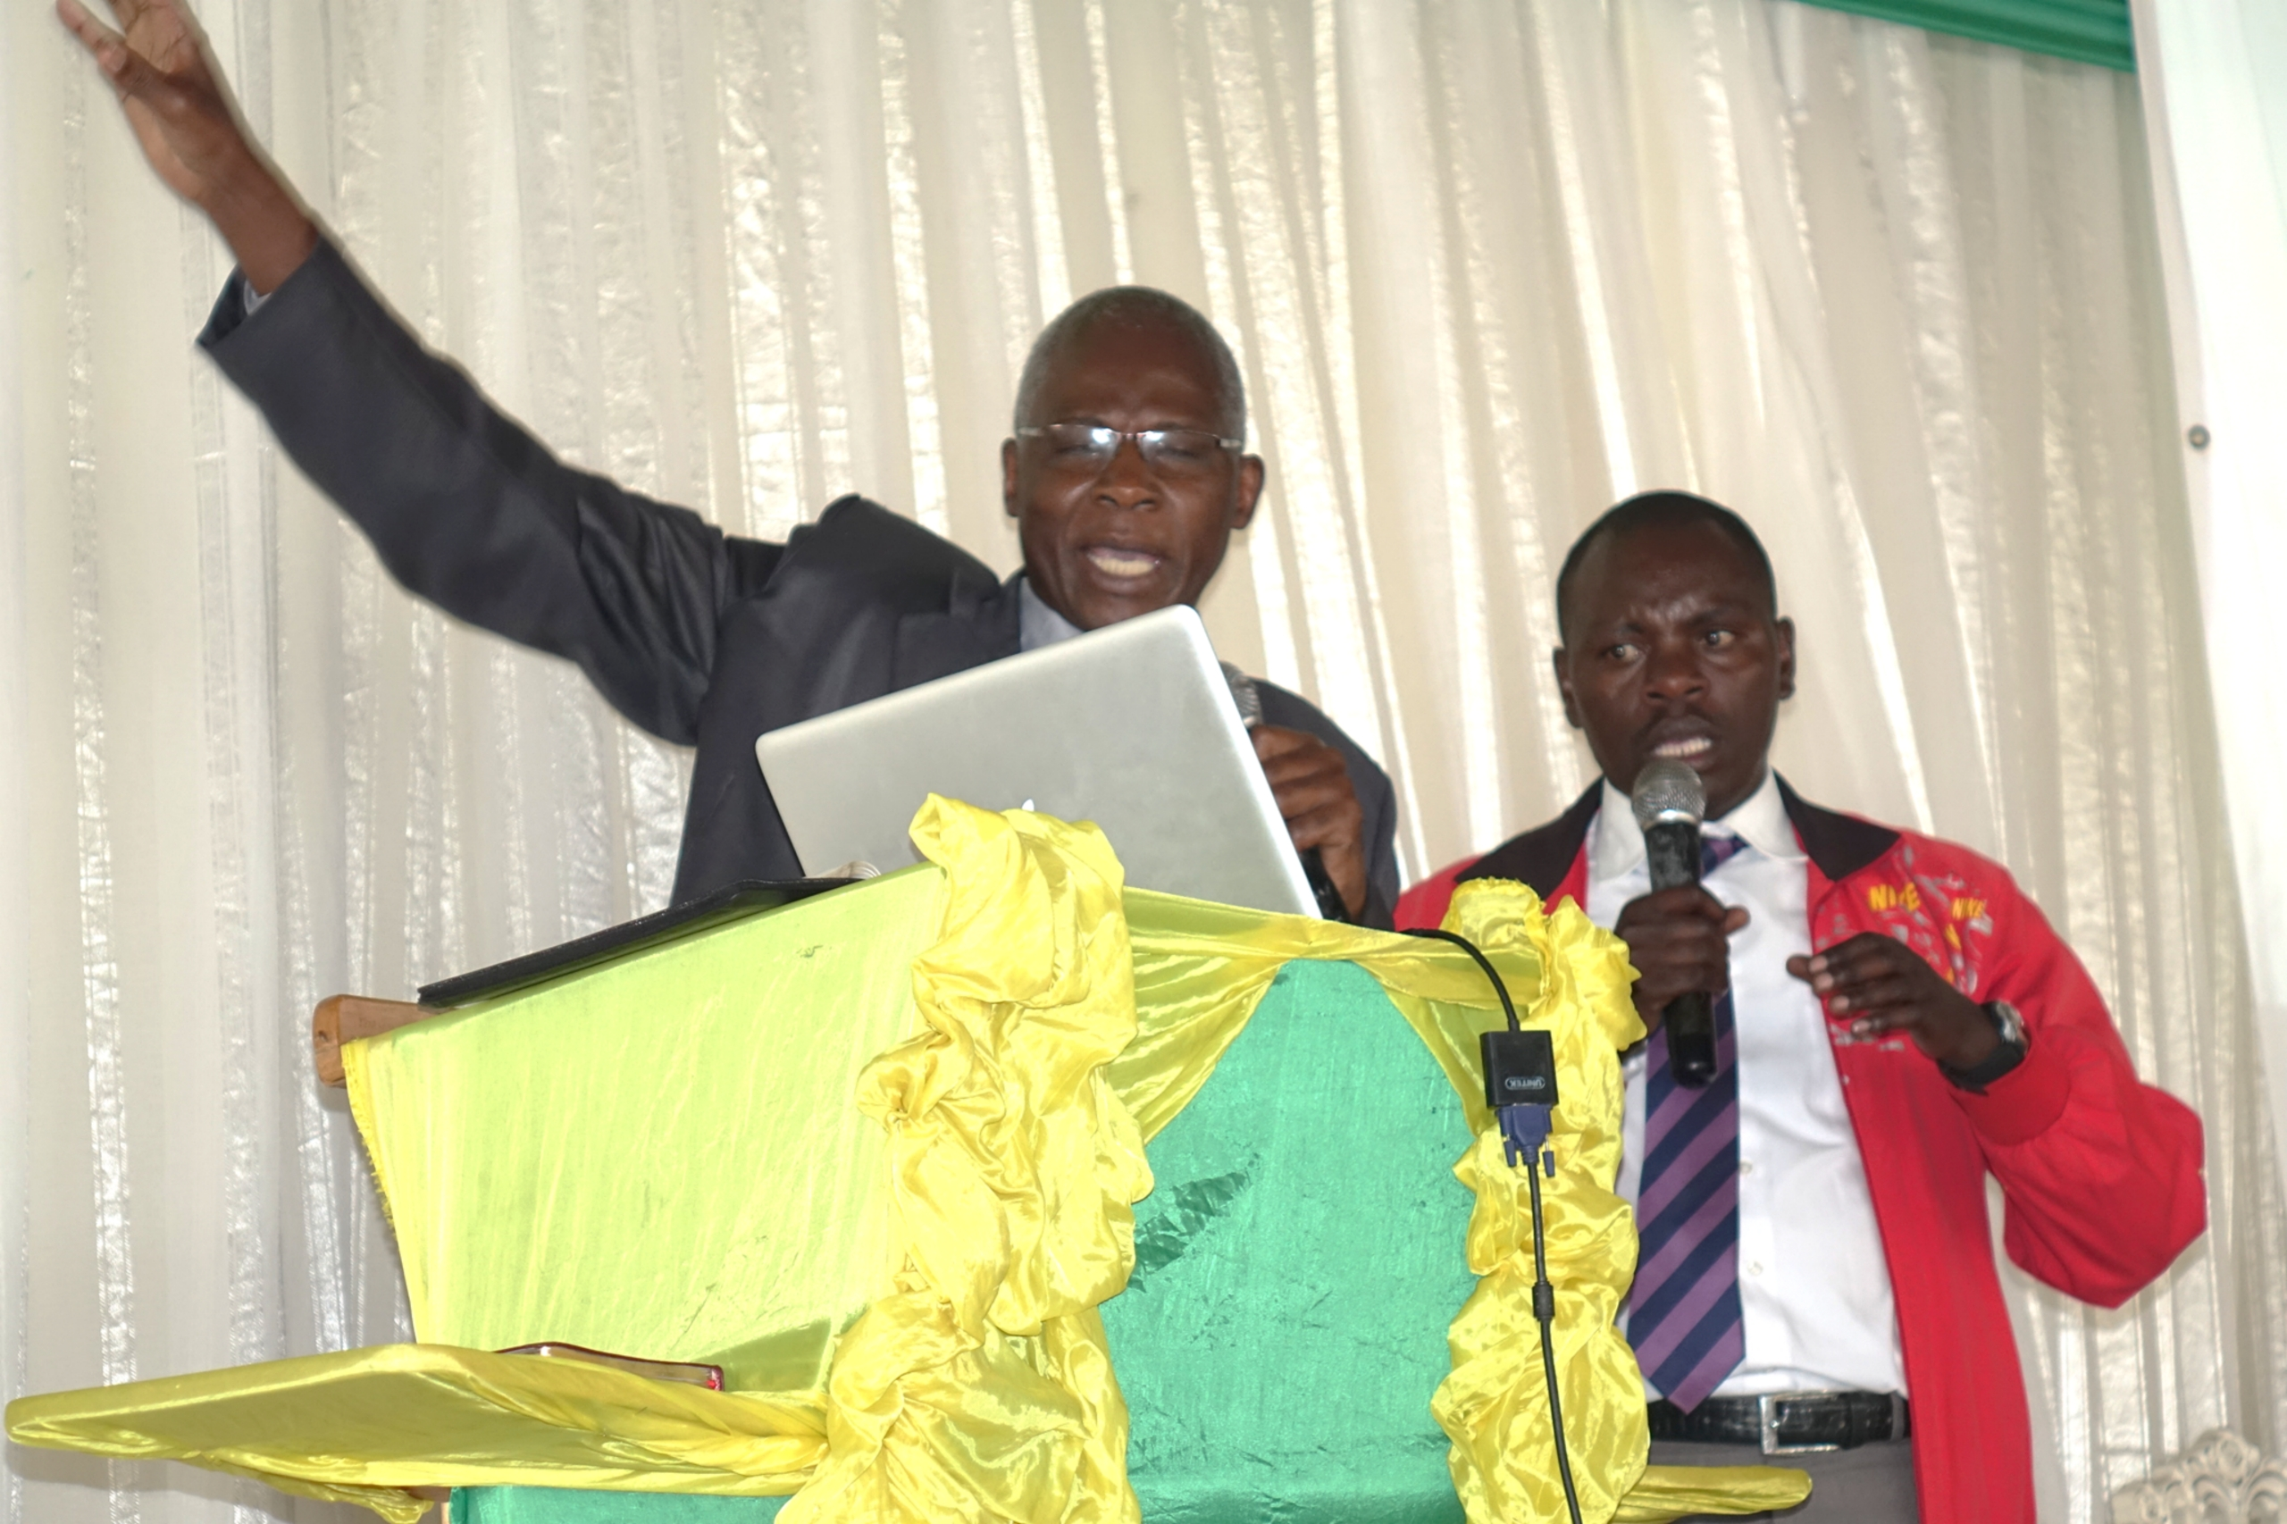
Pastor Paul Muasya, Director, Division Special Needs Ministries
A Visionary Leader

Slide 7
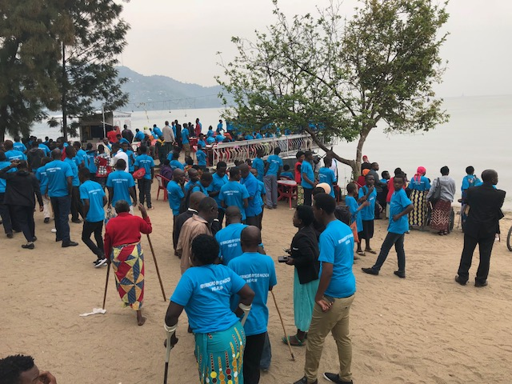
Responding to an invitation to follow Jesus and be baptized

Slide 8
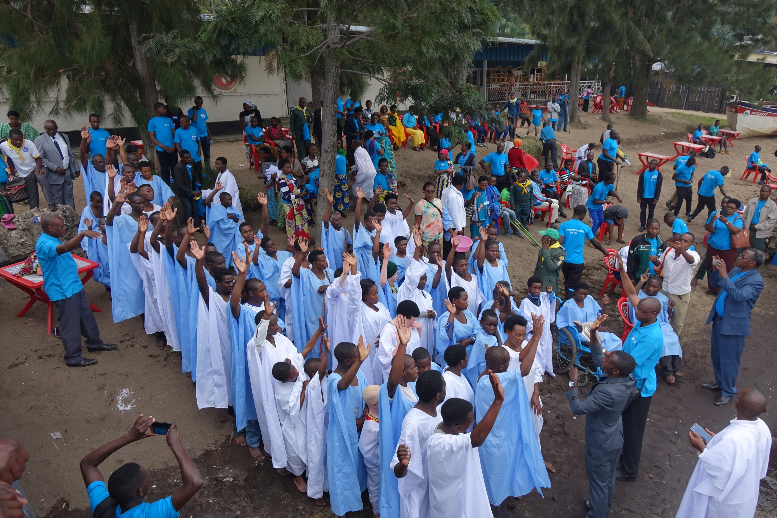
86 Special Needs Individuals Baptized

Slide 9
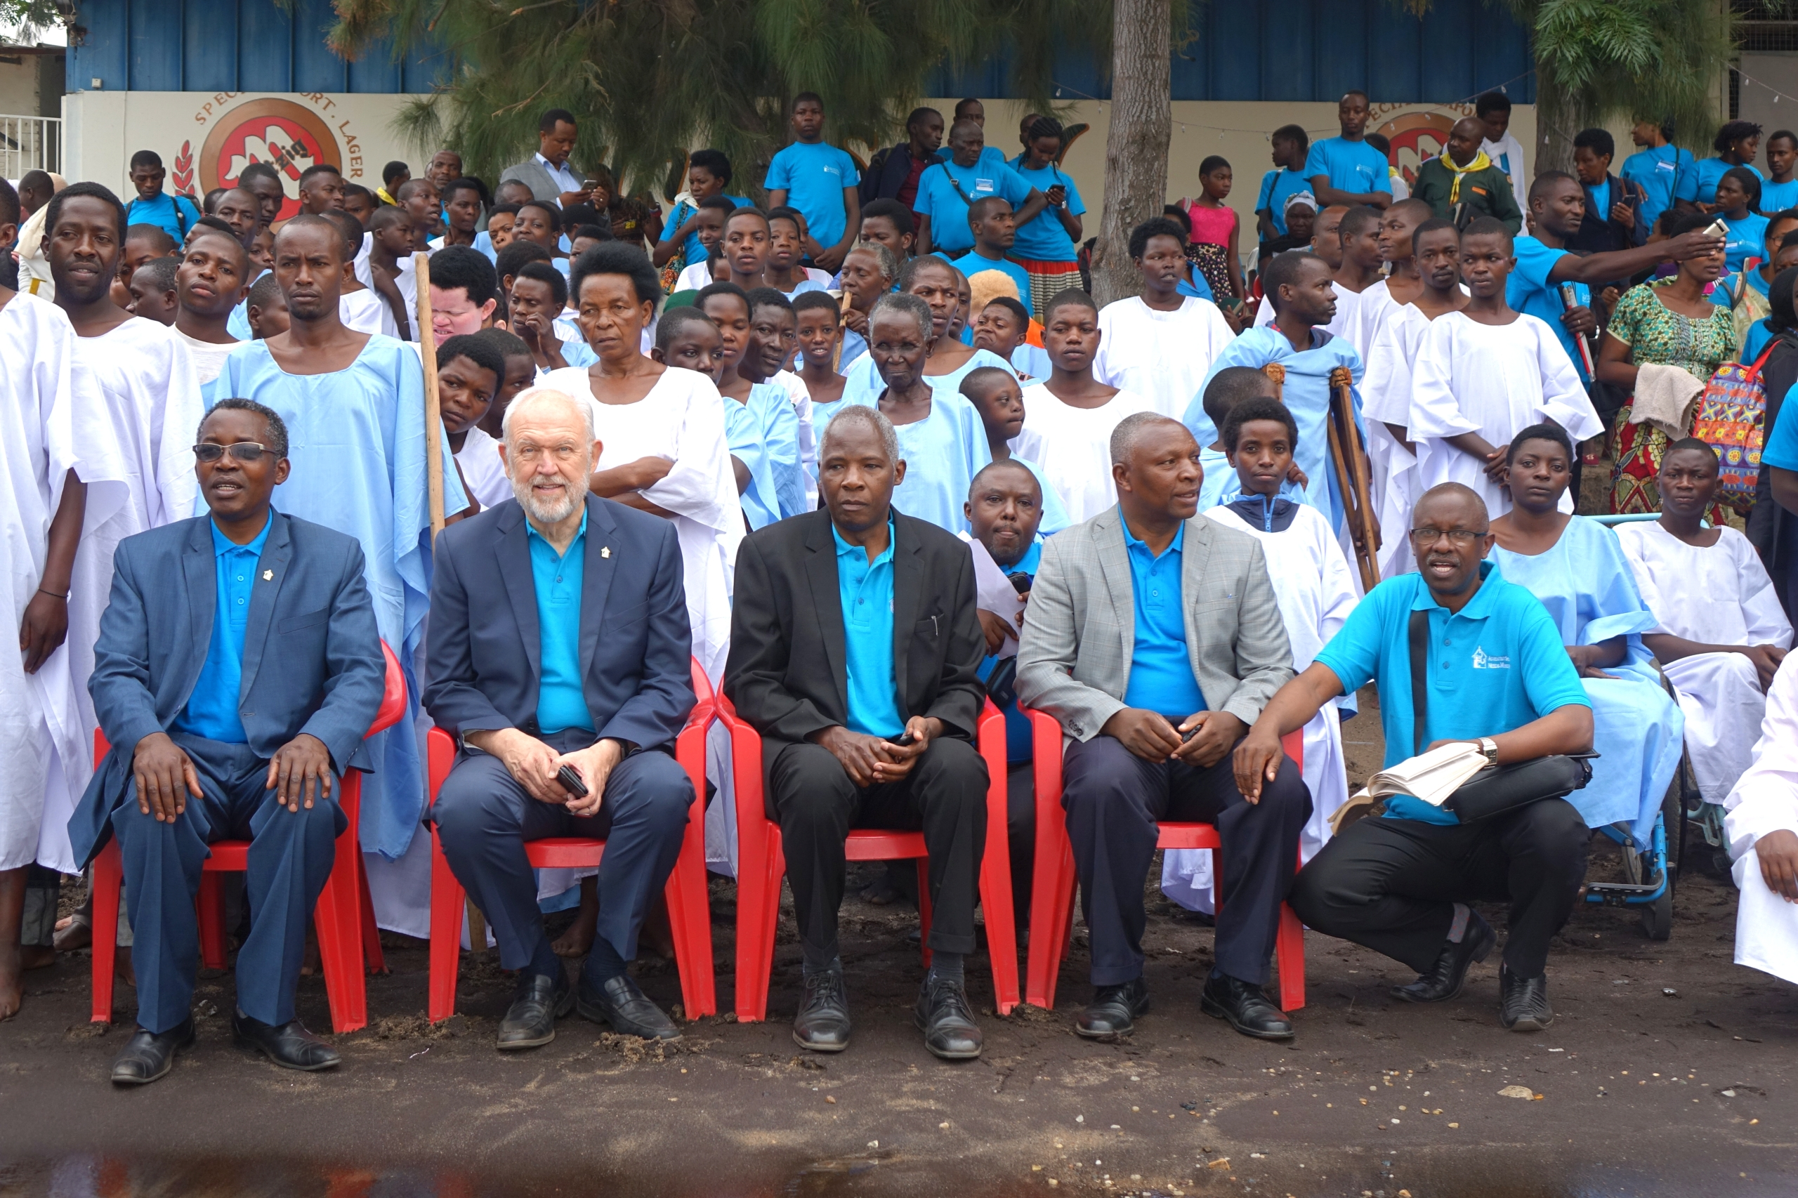
Division,
Union
Leaders
Seated in
front of
baptismal
candidates

Slide 10
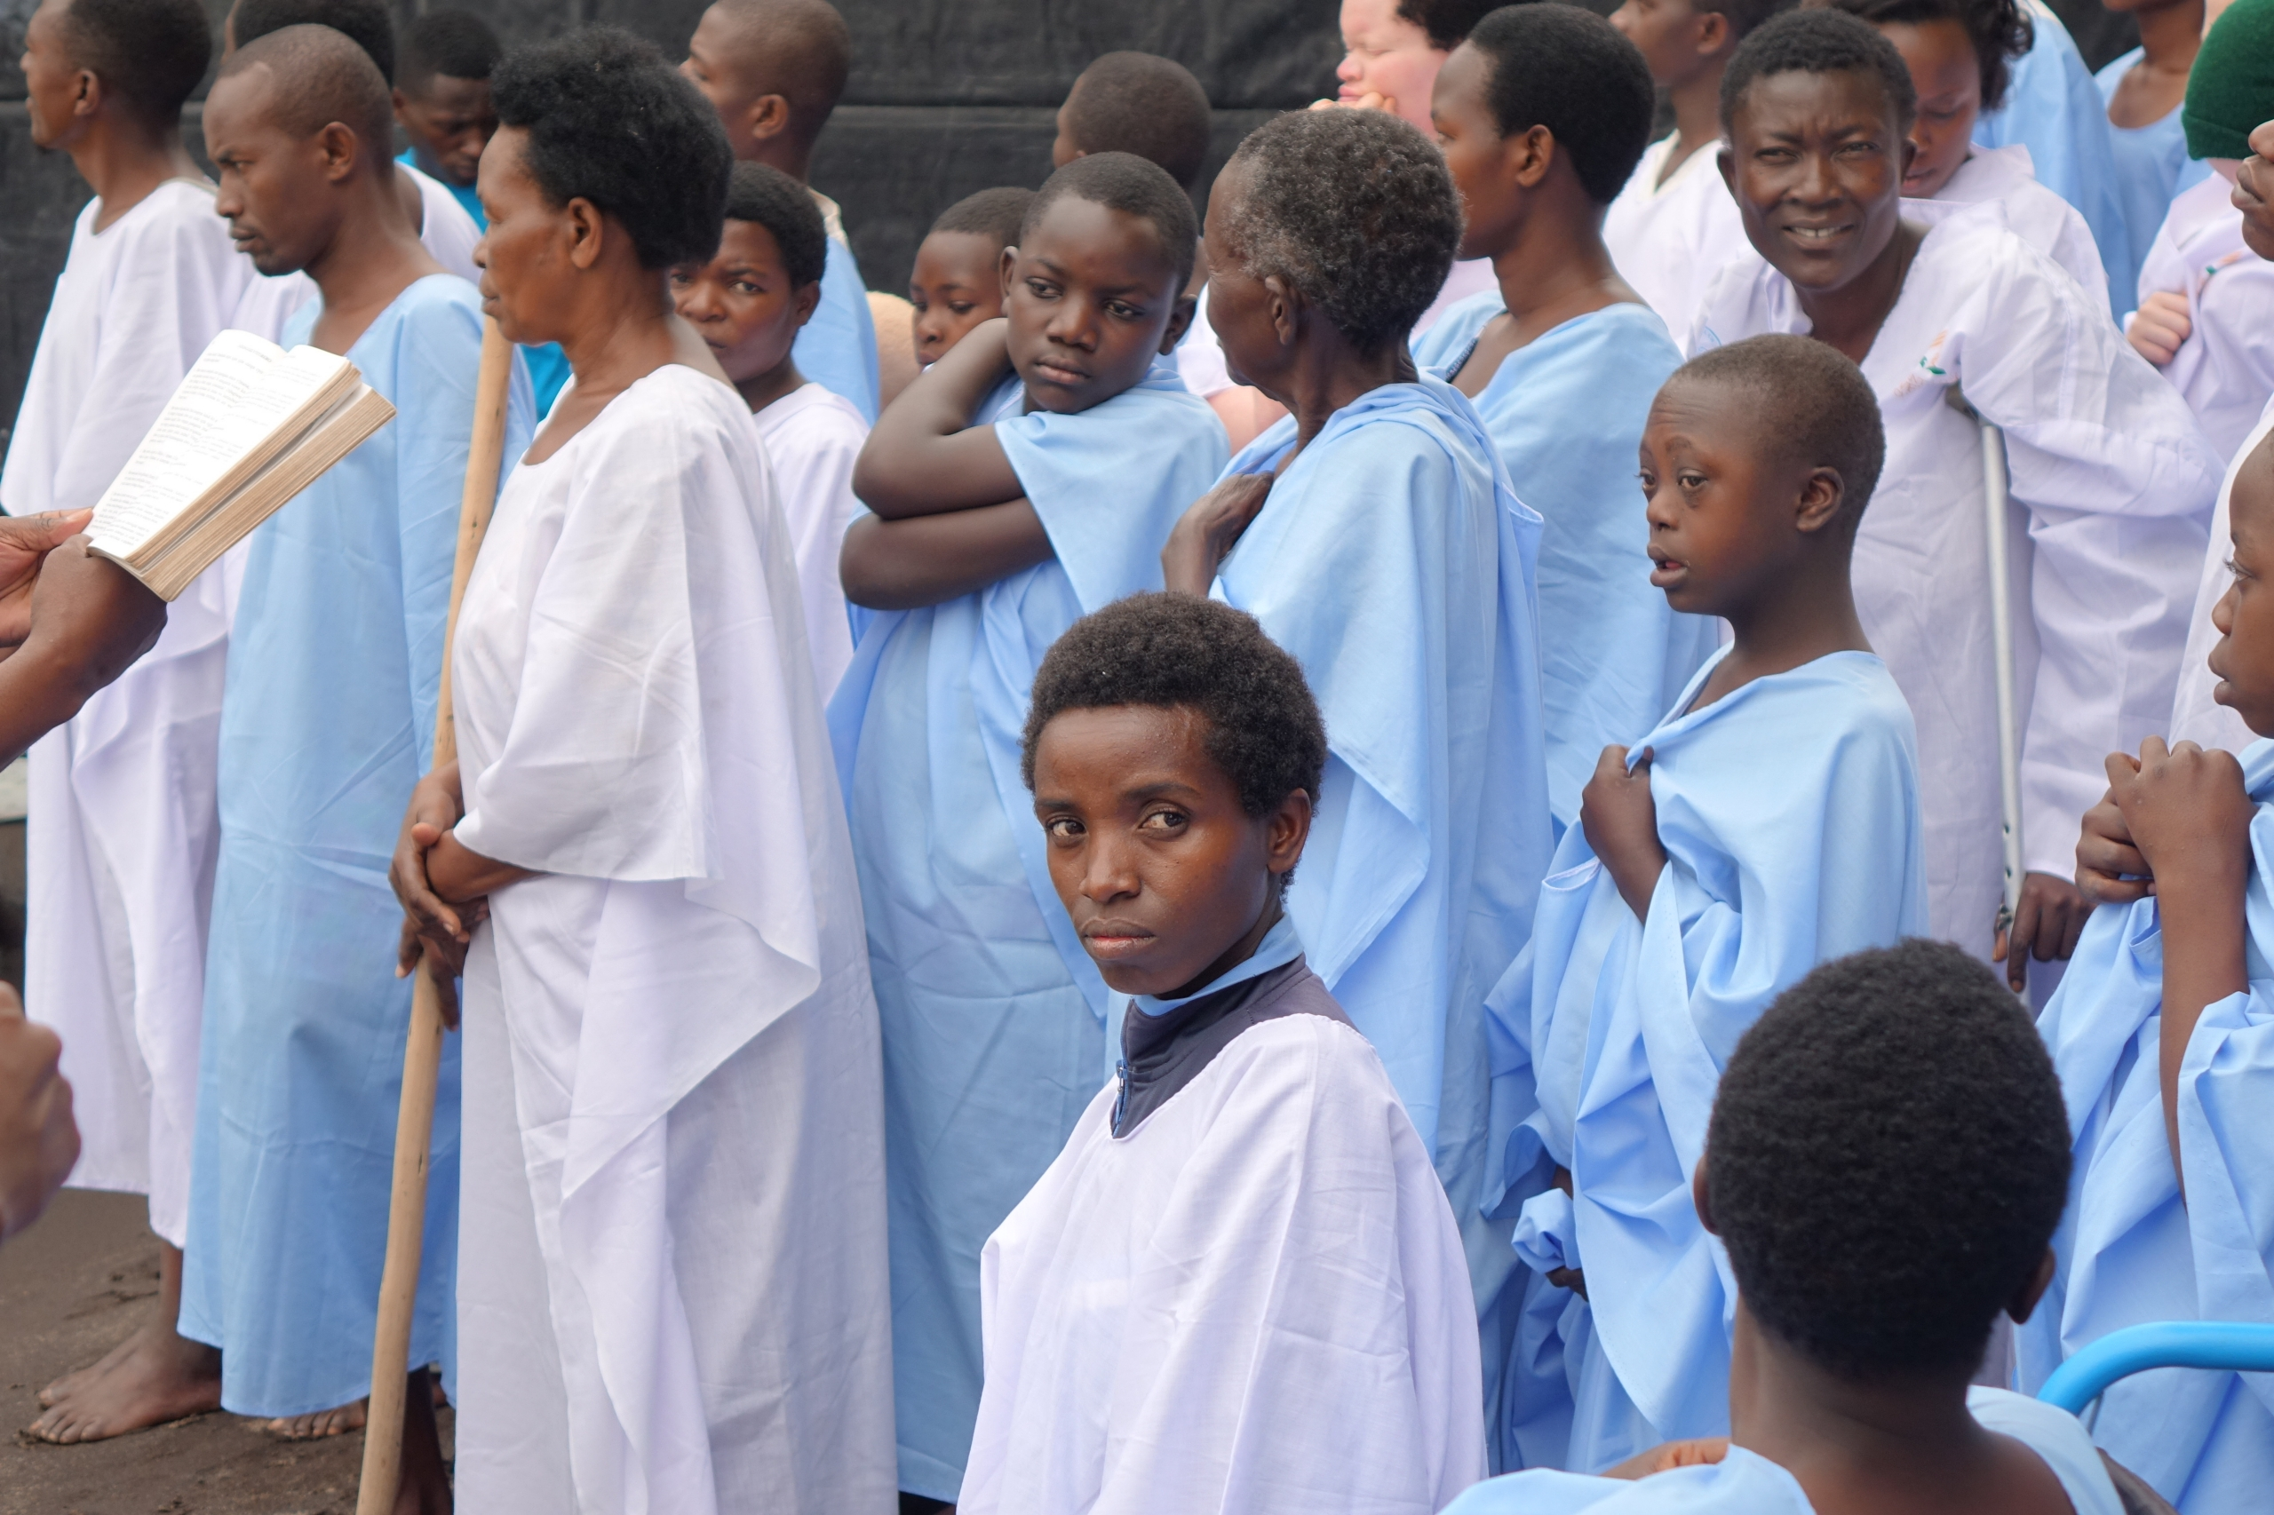

Slide 11
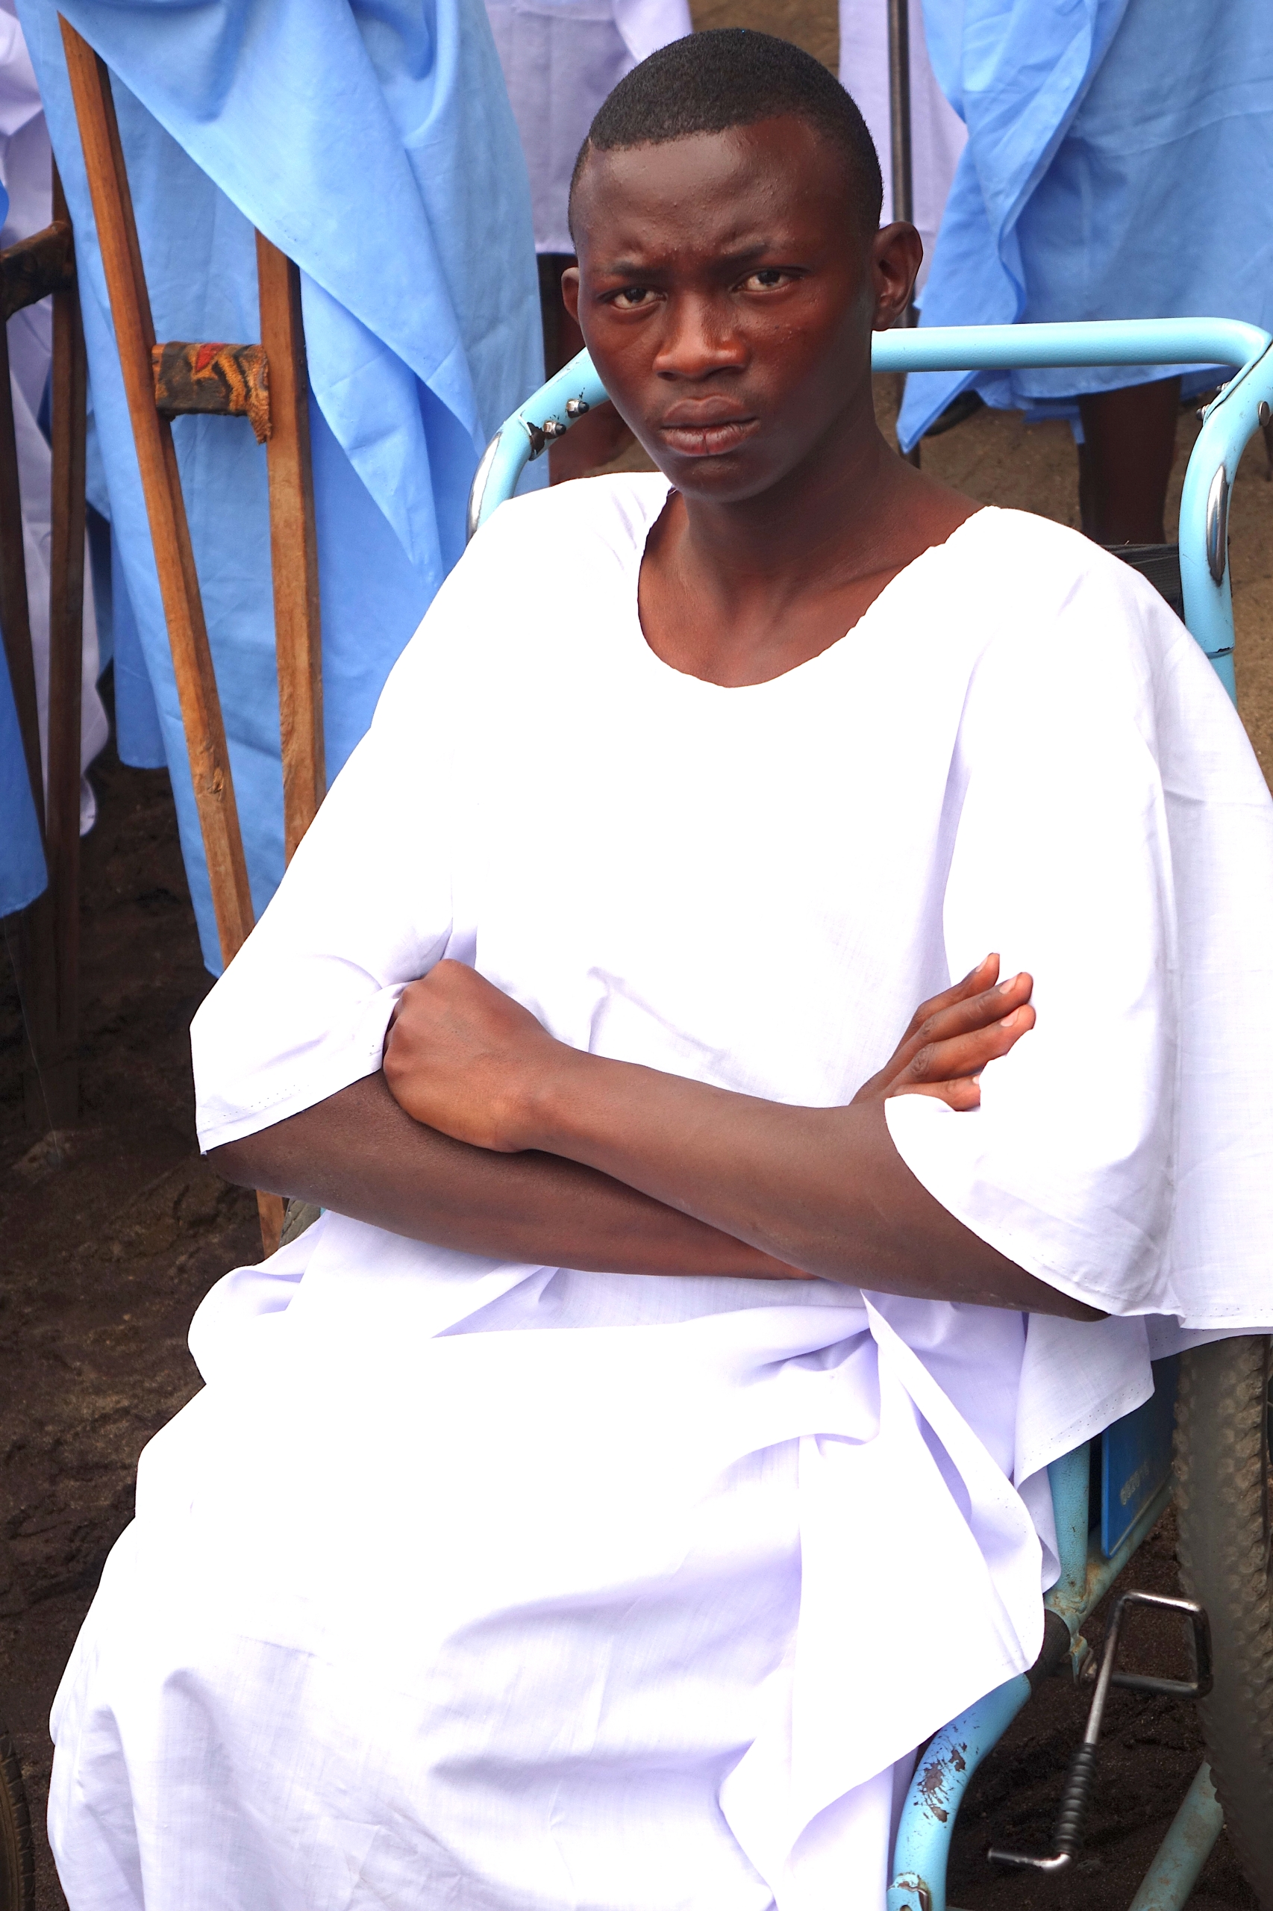

Slide 12
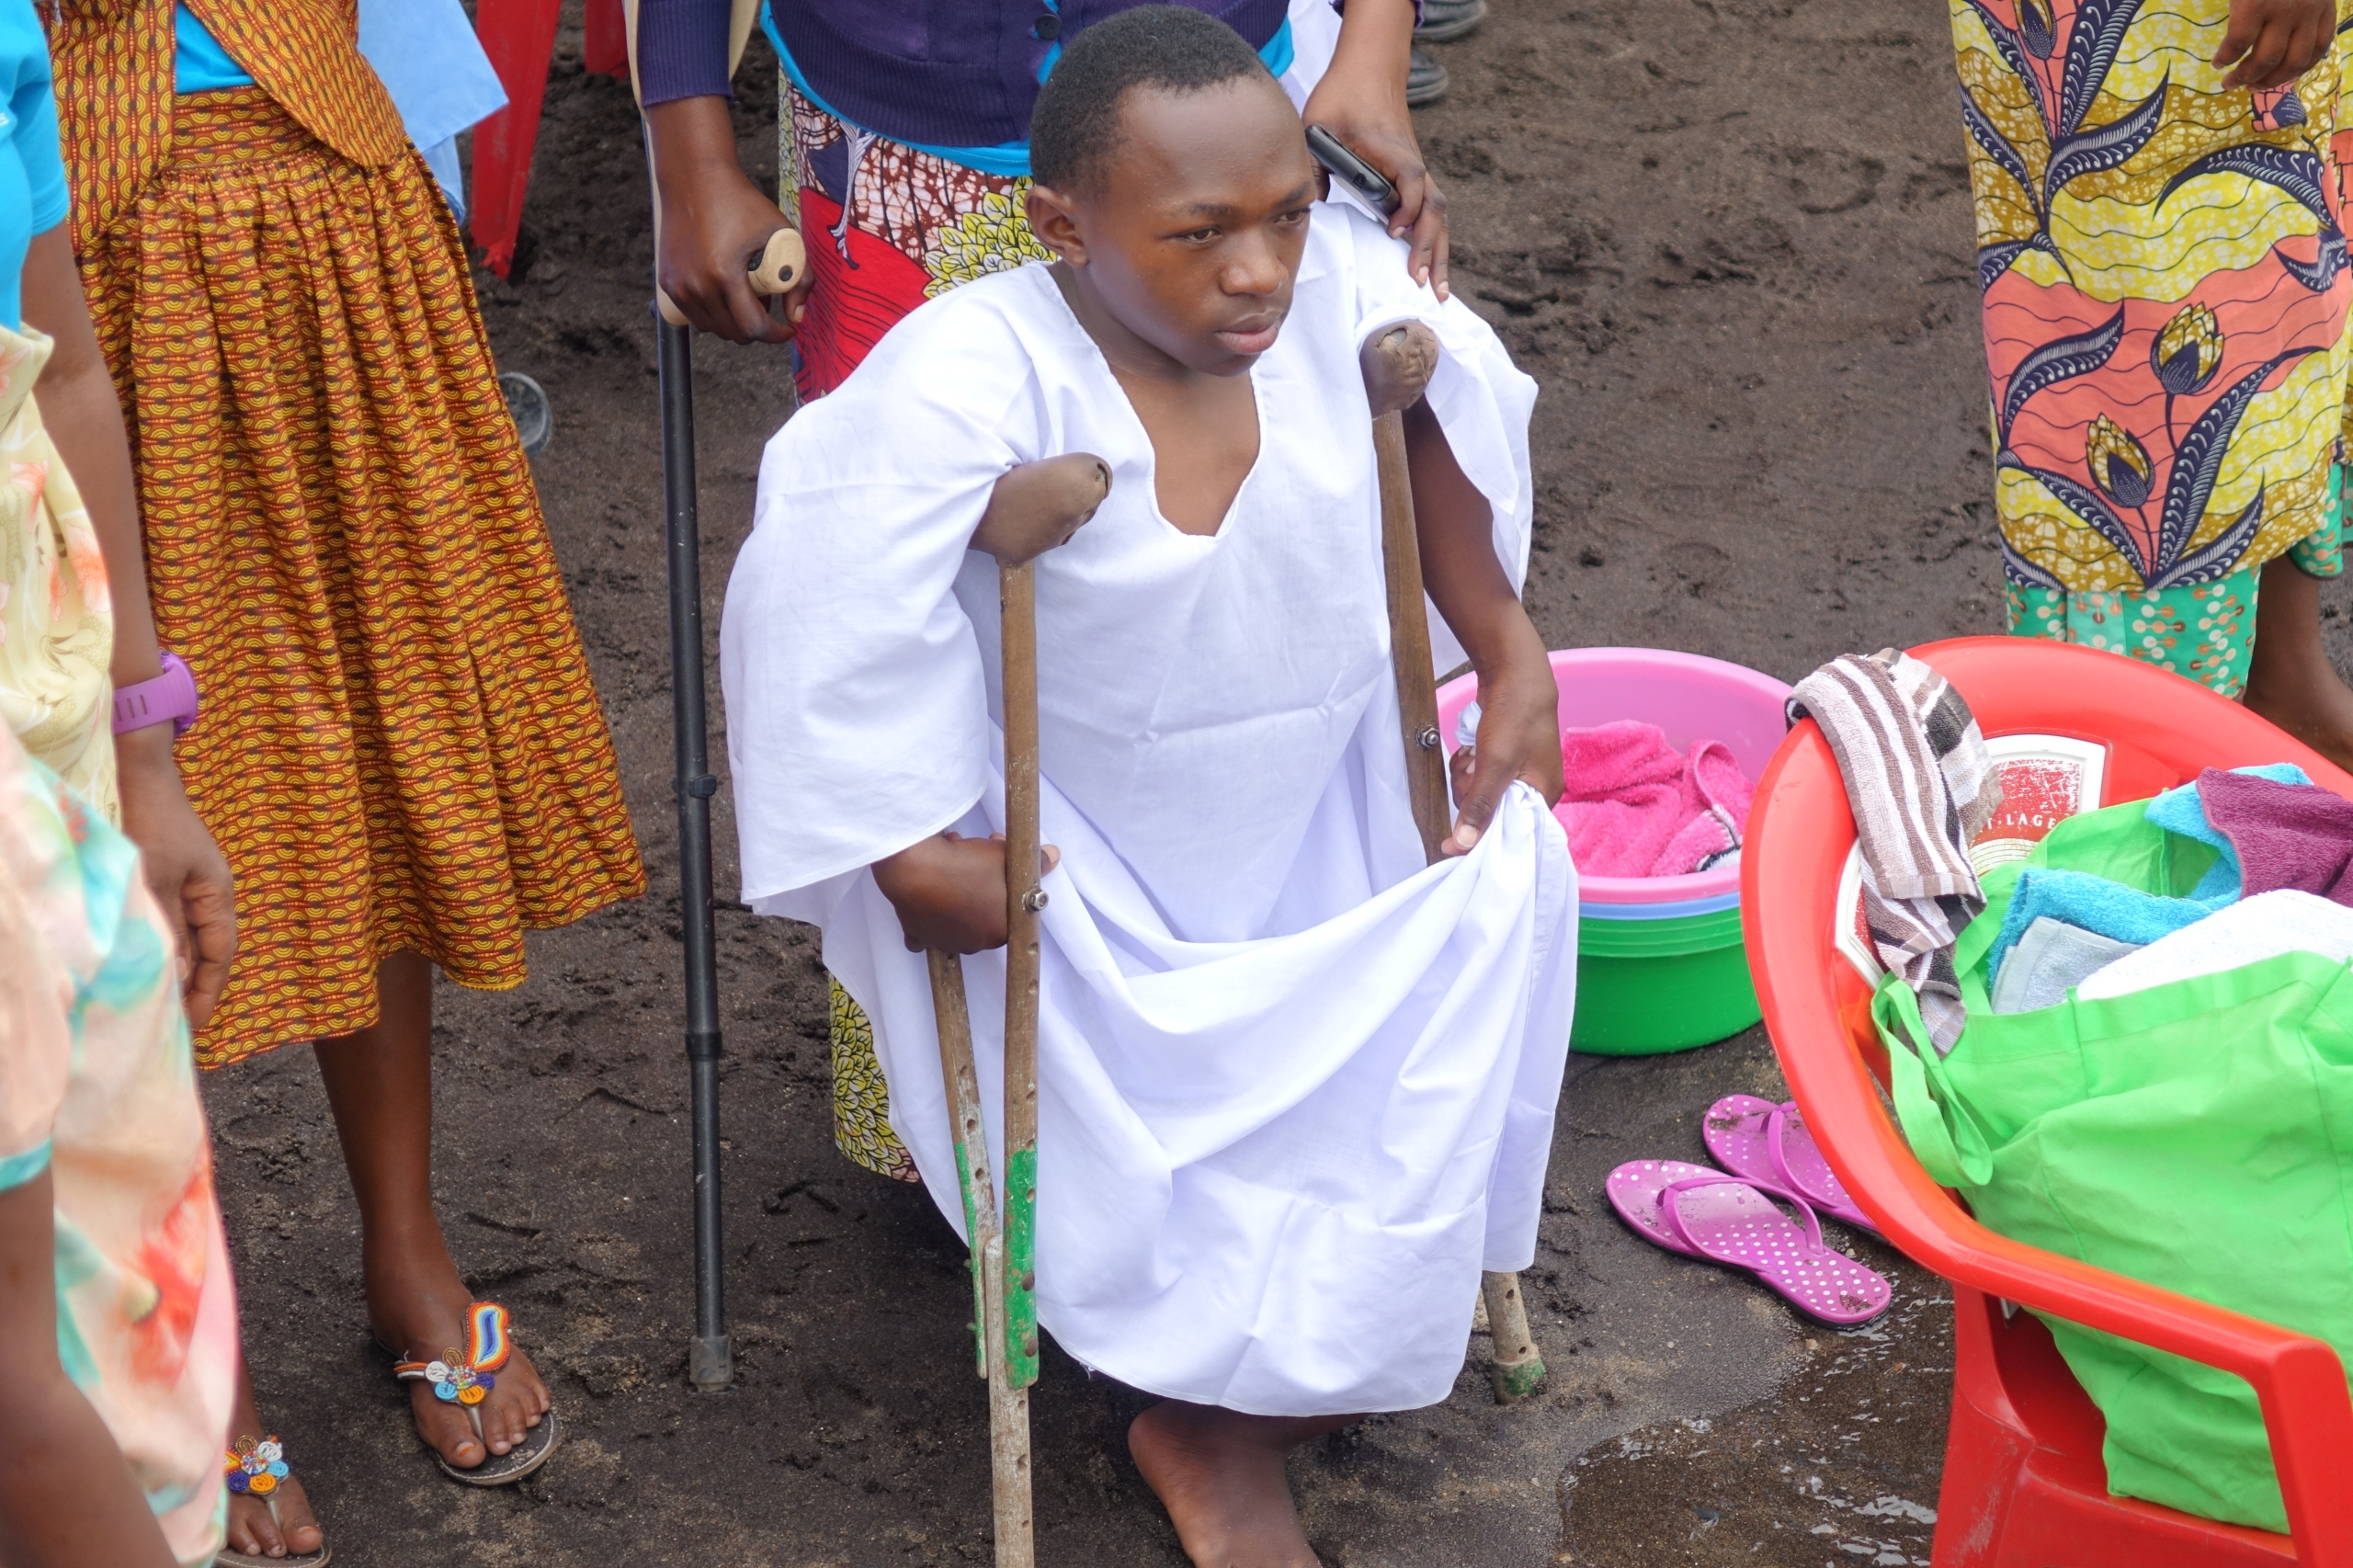

Slide 13
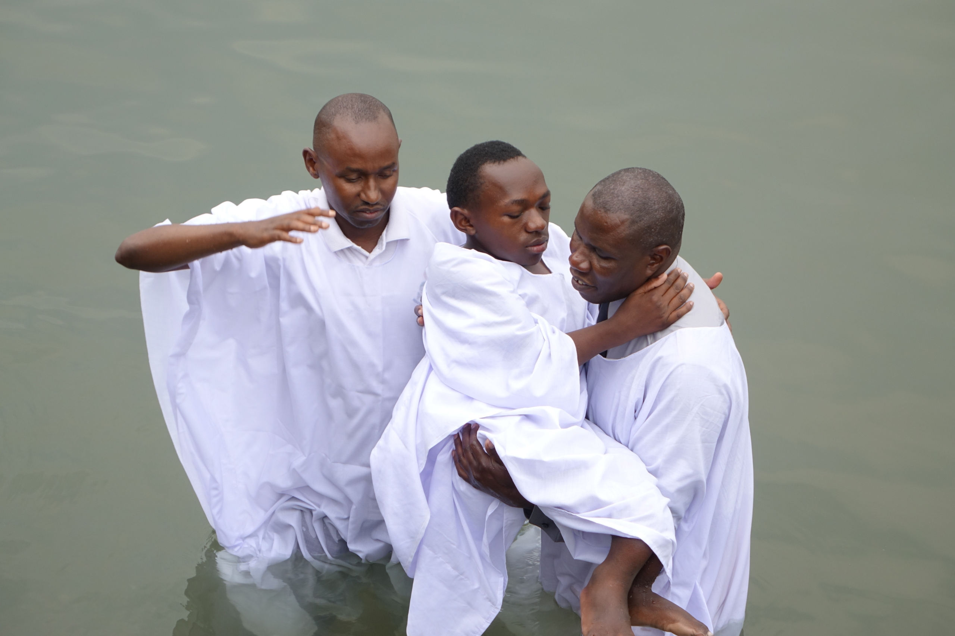
I Asked Myself:
They have been here all the time – ever since the days of Christ;
Where have we been?

Slide 14
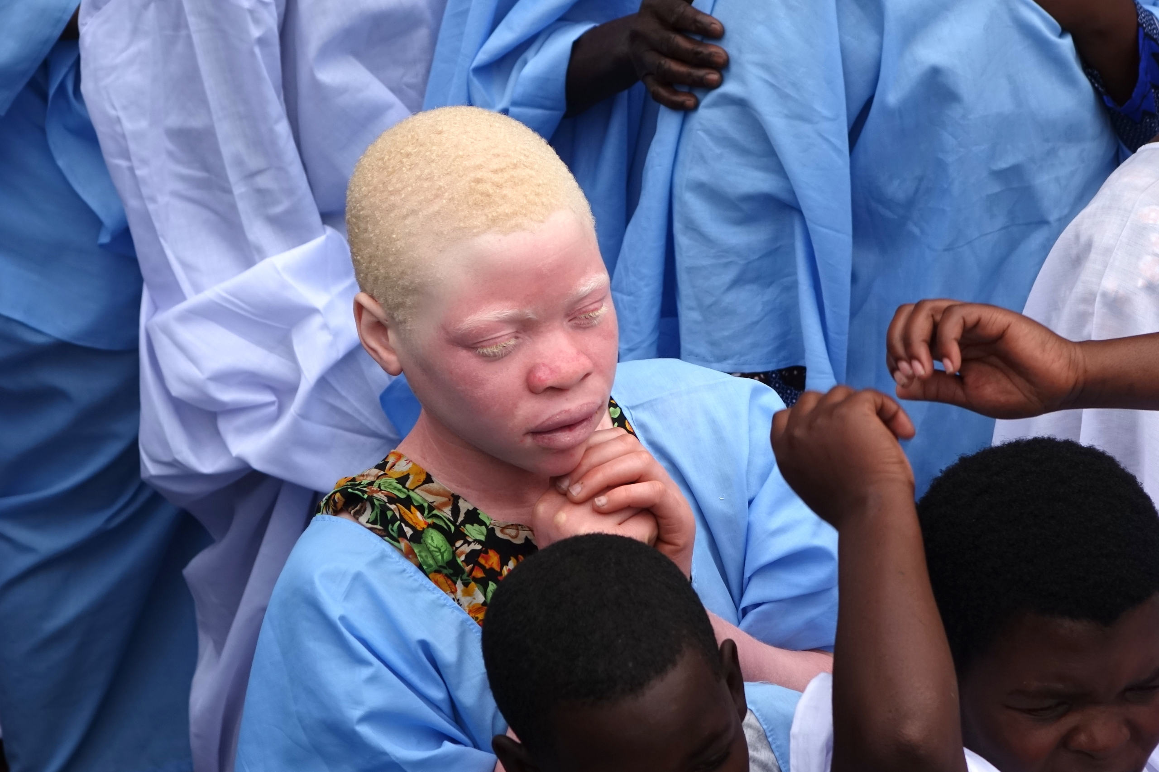

Slide 15
Gifted Wheelchairs Distributed

Slide 16
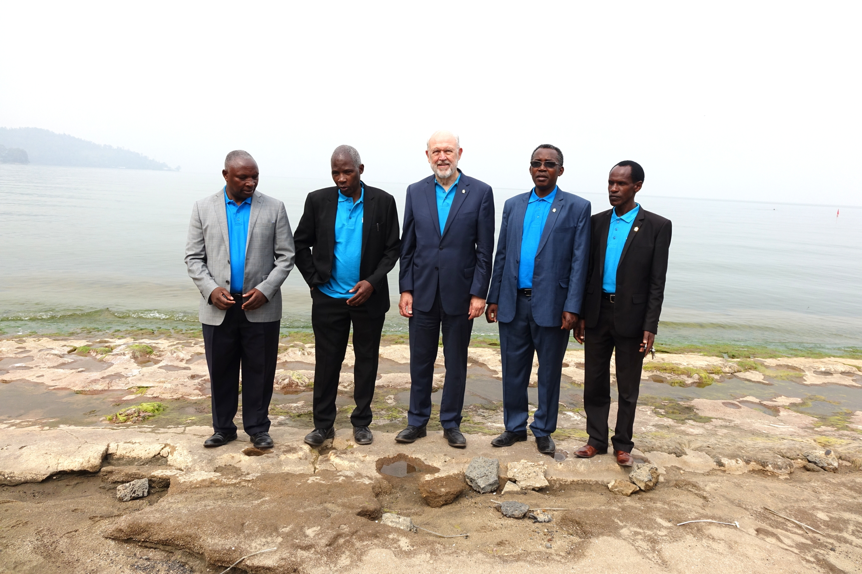
Don’t Try to Tell Those Standing with Me that Those with Special Needs Won’t Respond To an Invitation to Accept Jesus

Slide 17
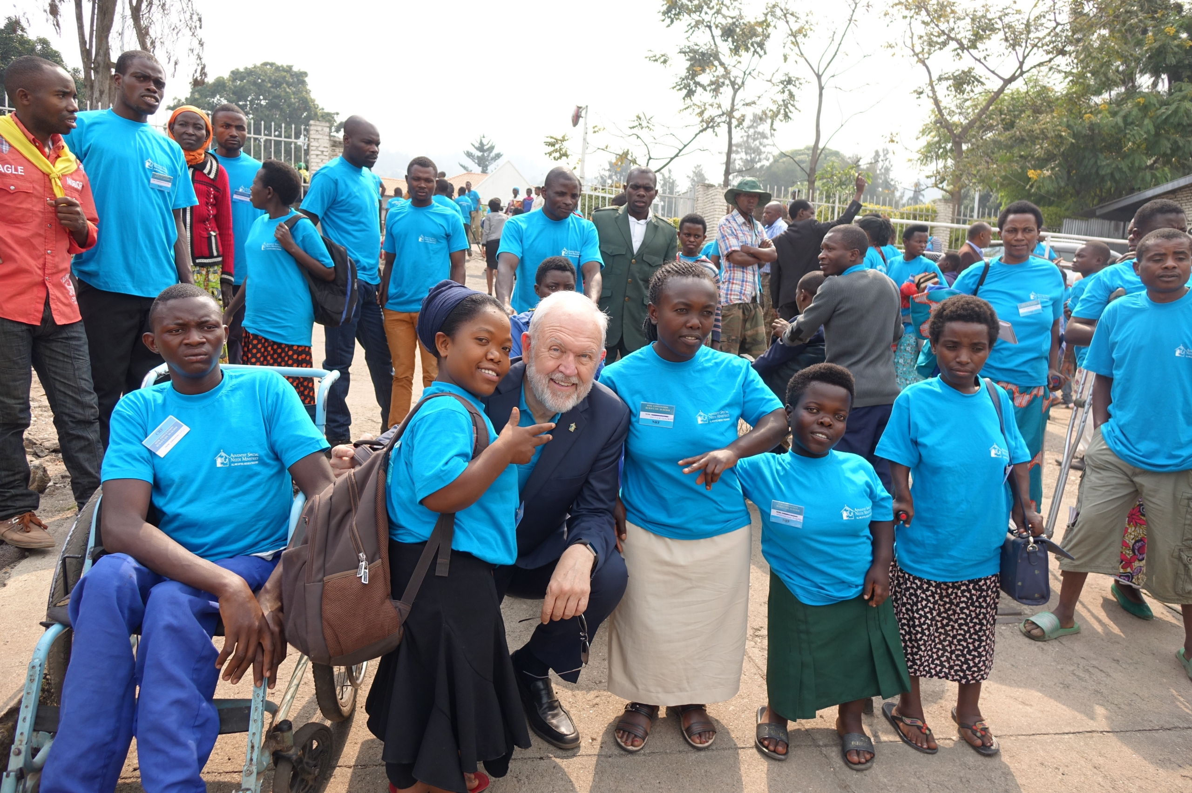
Never Judge a Person by Their Stature . . . God Doesn’t

Slide 18
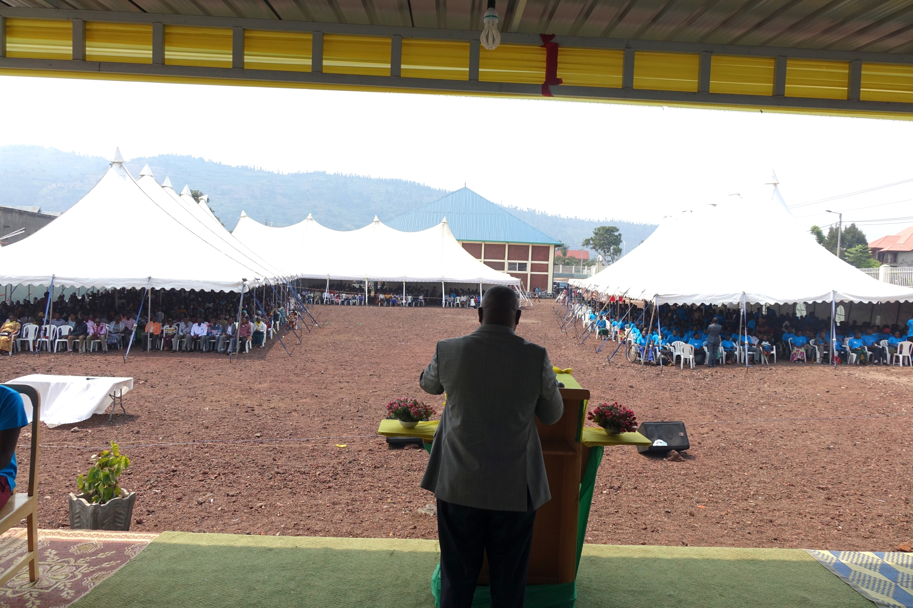
An Amazing Evidence of What Can Happen When We Partner with God

Slide 19
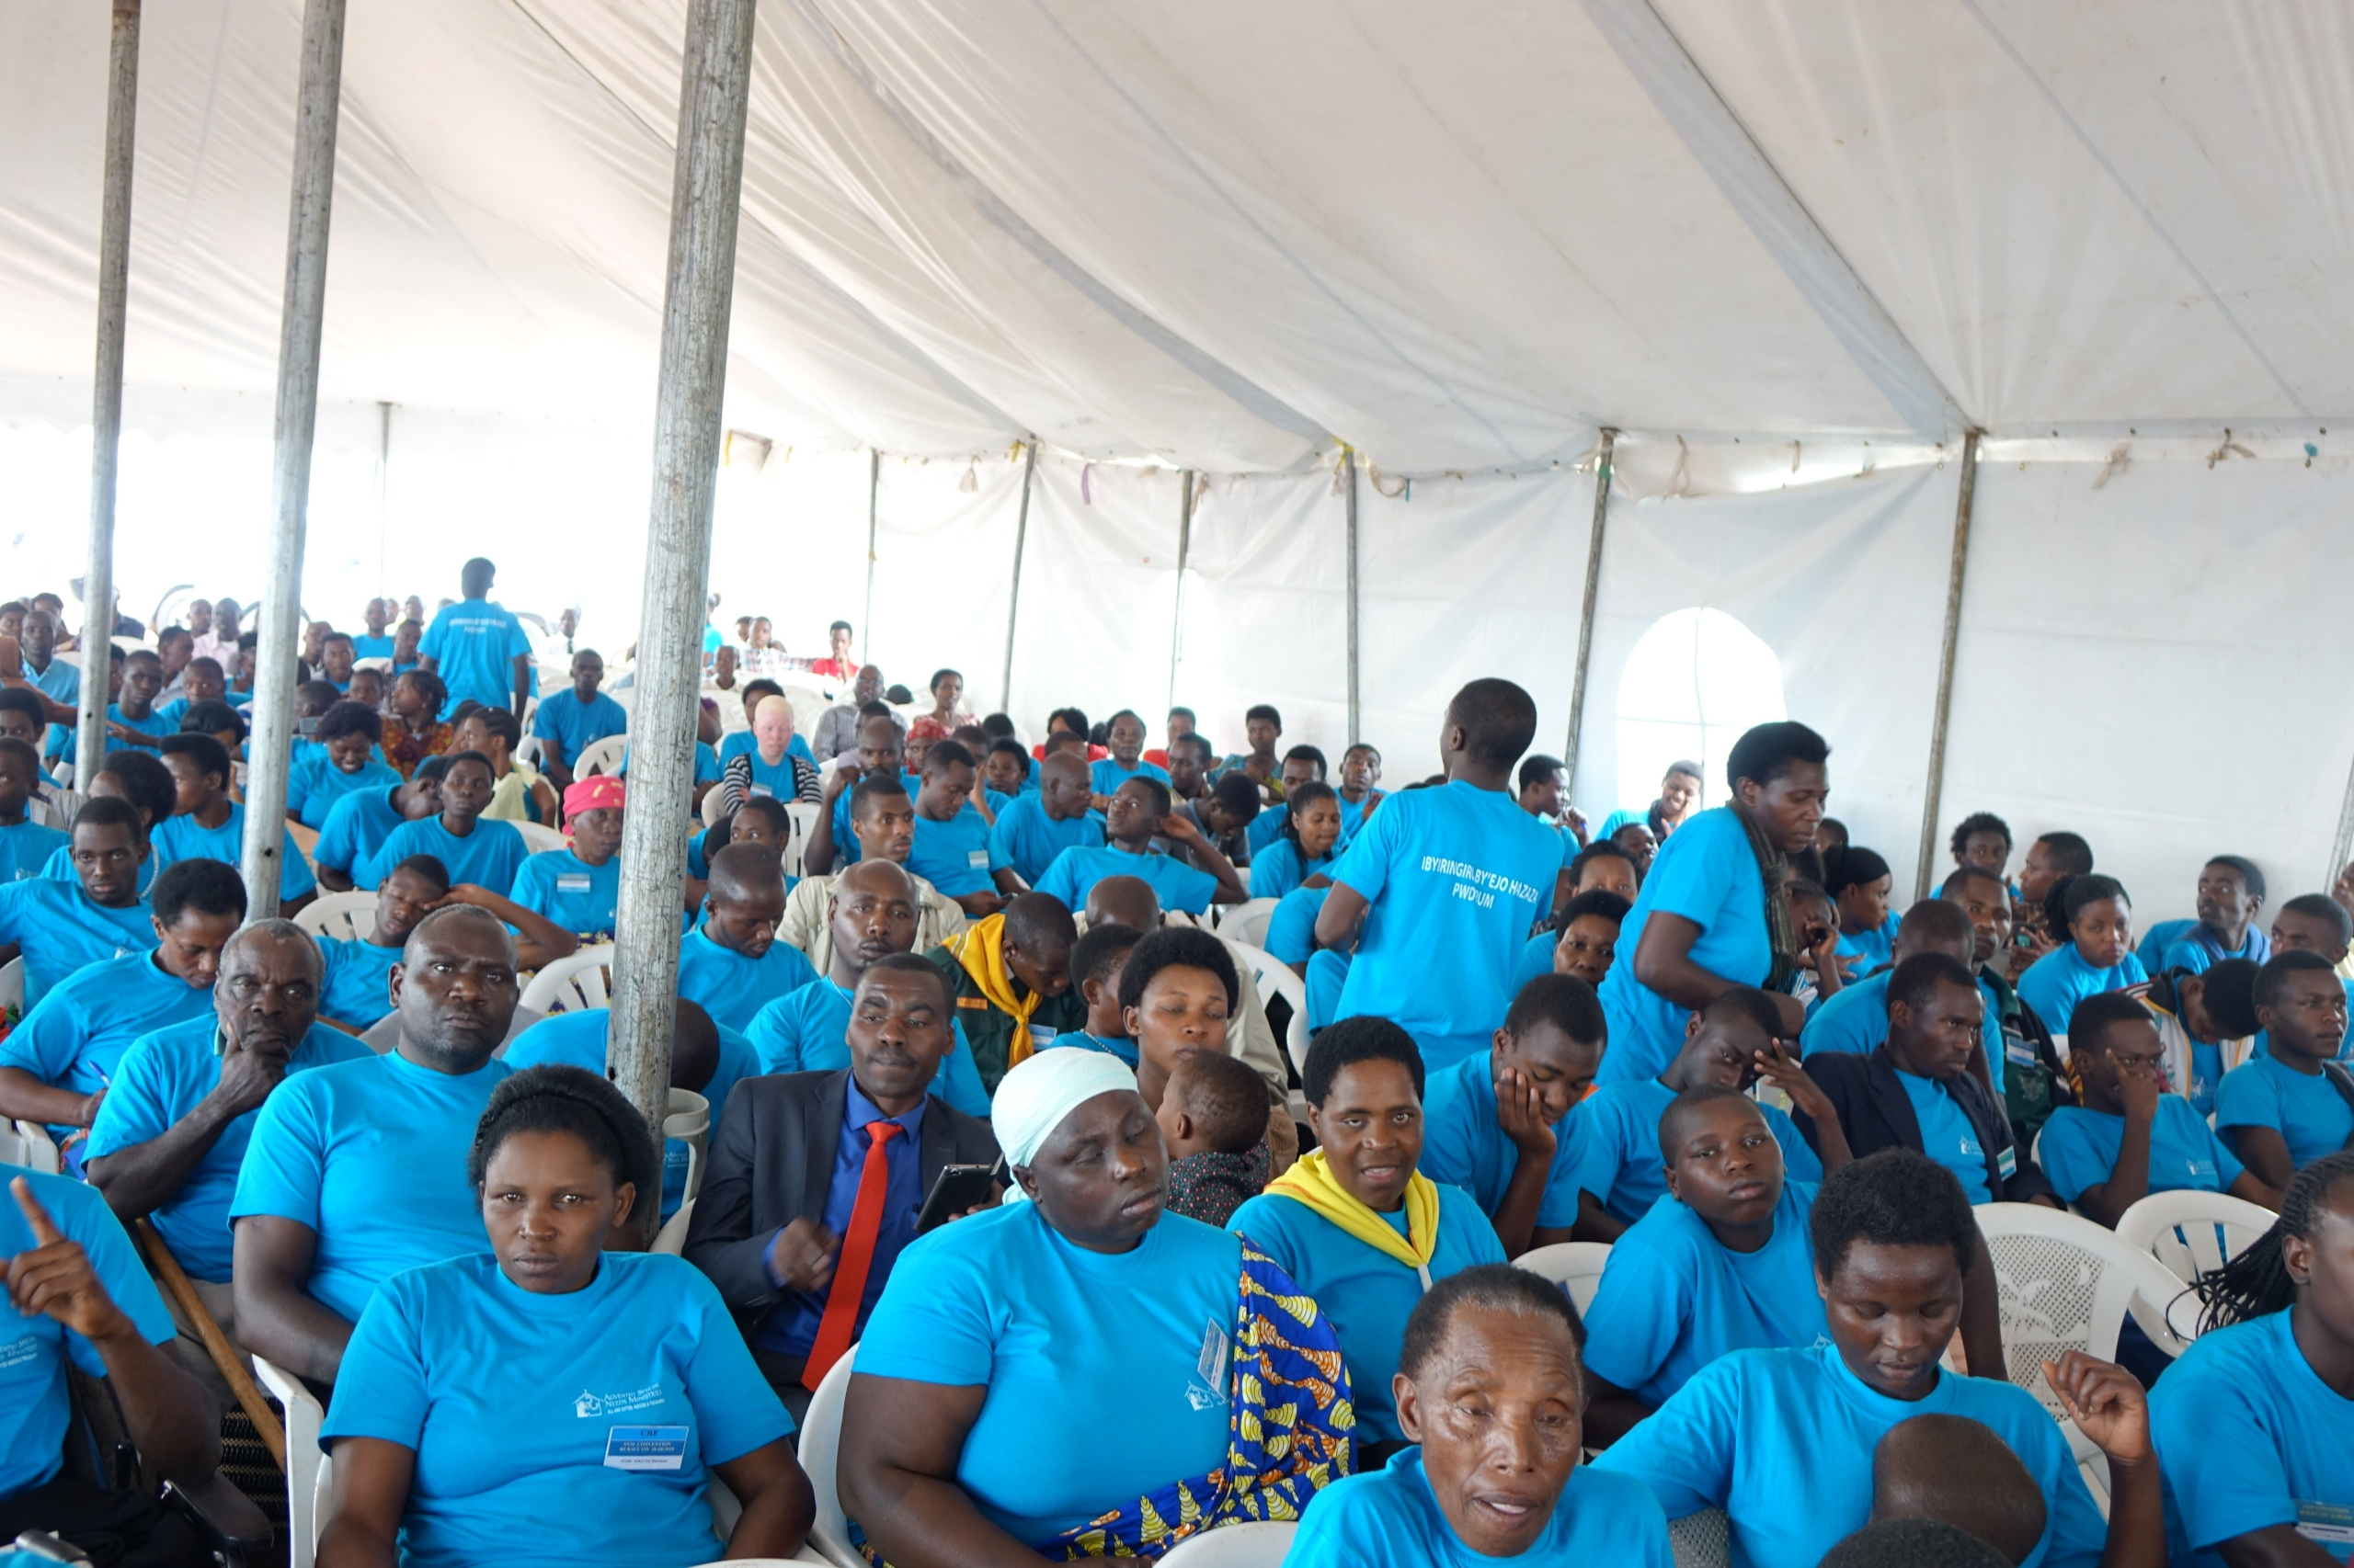
A camp meeting
for those with
special needs
It begins with the Gospel Commission;
Leadership turns it into a vision.
An the church
responds with
compassion.

Slide 20
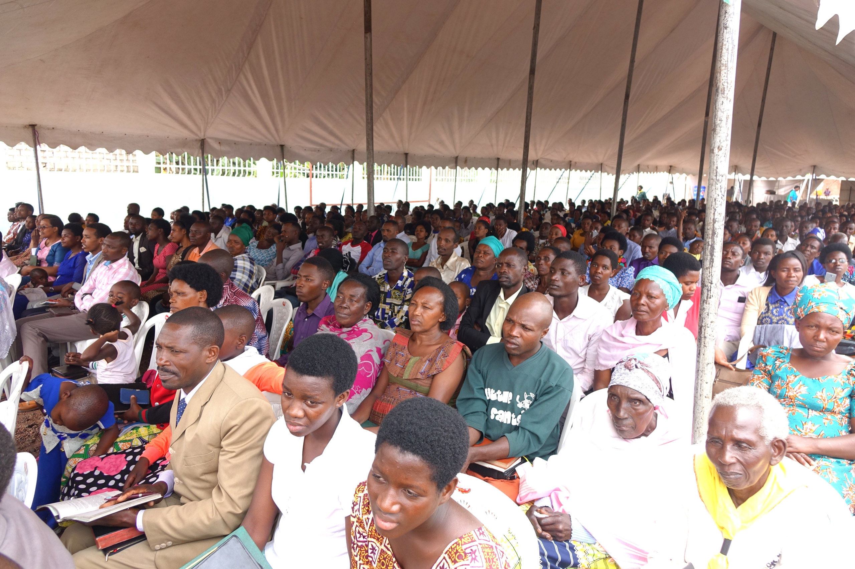
Compassion
is
contagious
Others
joined
the camp
meeting!

Slide 21
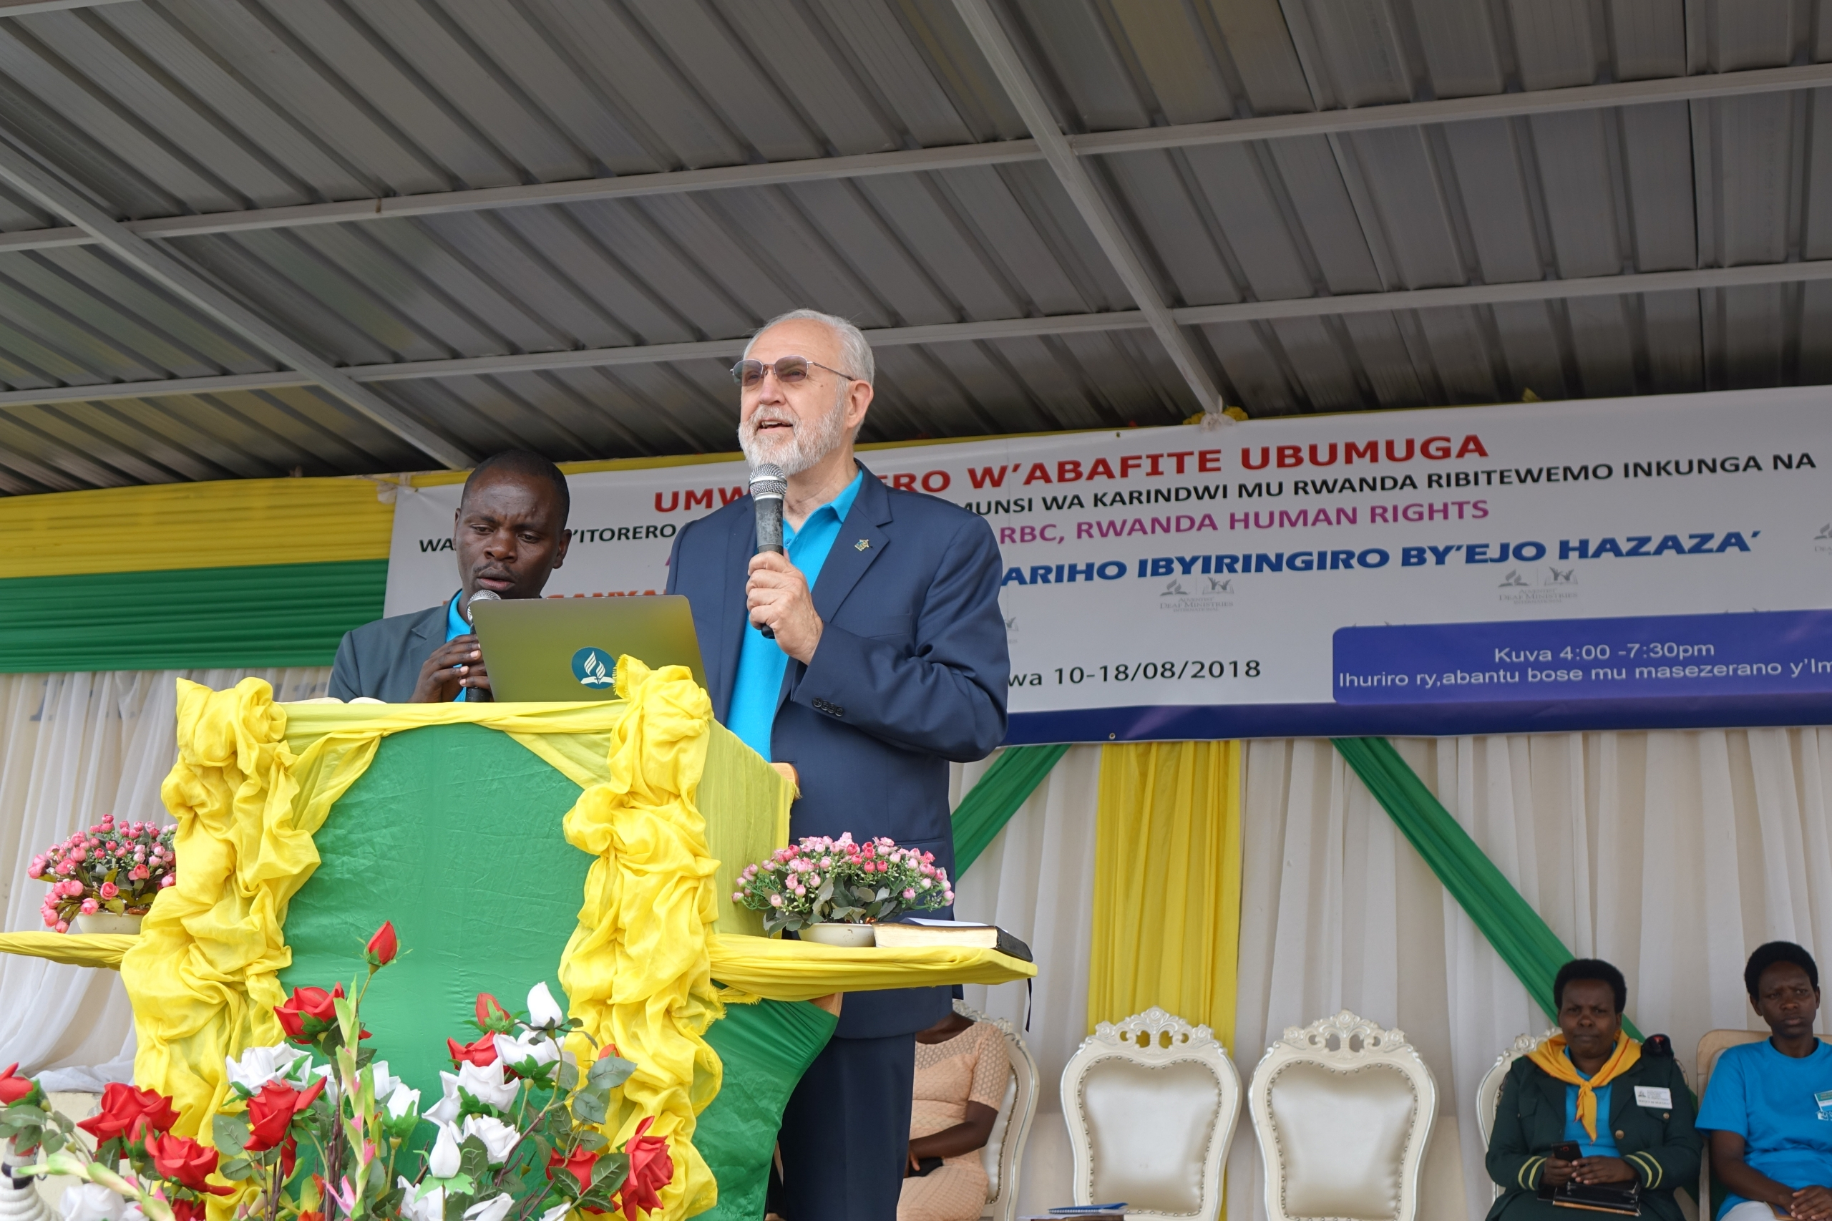
I wish you could have seen what I saw that Sabbath!

Slide 22
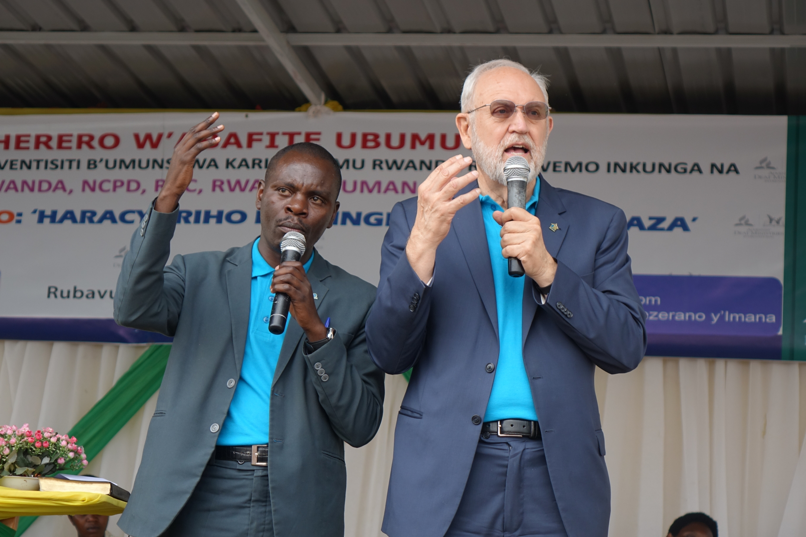
The Privilege of Sharing Is Never Taken for Granted

