Slide 1
Kenya Special Needs Camp Meeting & Training
August 19-26, 2018
Larry R. Evans, DMin
Asst to the President
Special Needs Ministries
General Conference of SDA

Slide 2
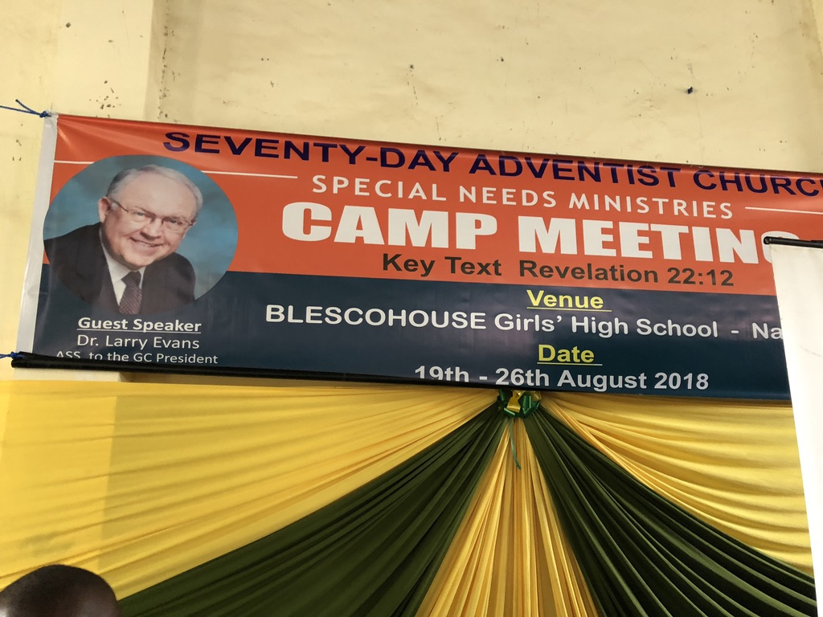
A key sustaining factor
in the growth of the Deaf and
Special Needs Ministries
in the East Central Africa
Division is its inclusive
approach and its Special
Needs Ministries Camp
Meetings. No one ever
feels excluded and an
emphasis is given to the driving principle: “All are gifted, needed and treasured!”

Slide 3
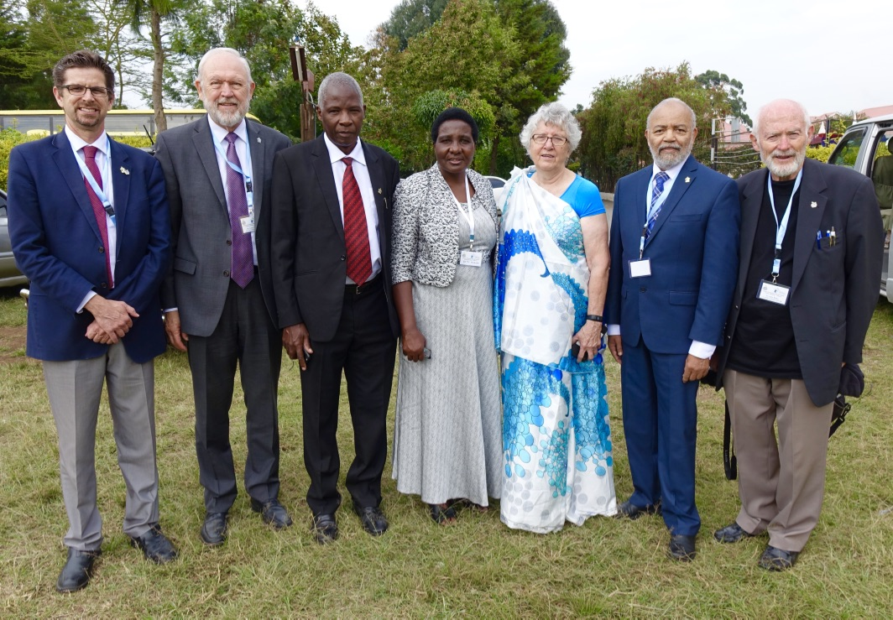
Our Leadership Team:
Jeff Jordan, Larry Evans,
Pastor and Mrs. Muasya,
Pat Gustin, Thompson
Kay and John Blake

Slide 4
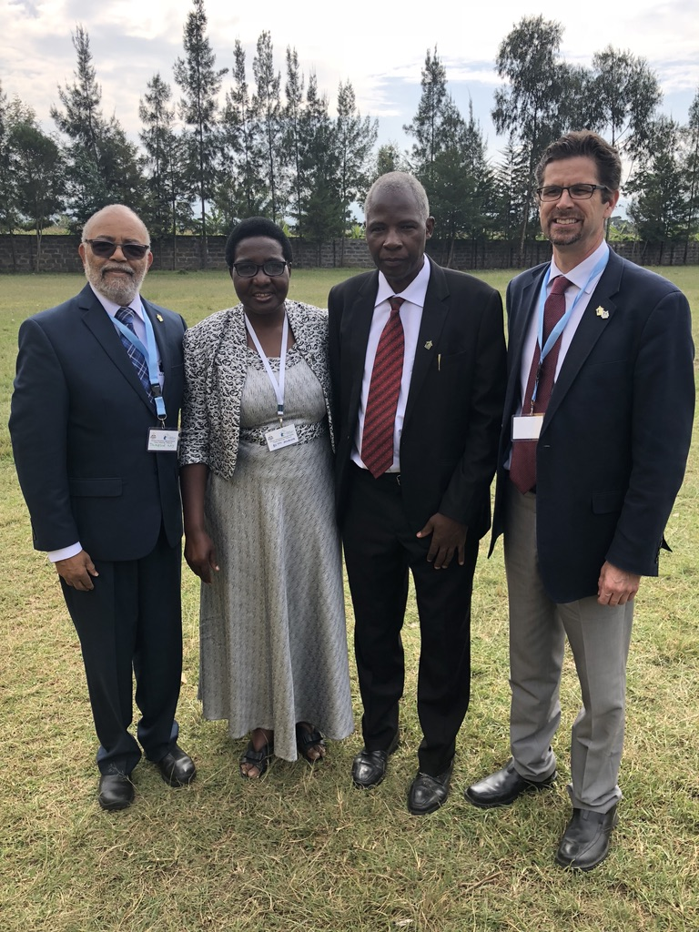
Some very special
colleagues!

Slide 5
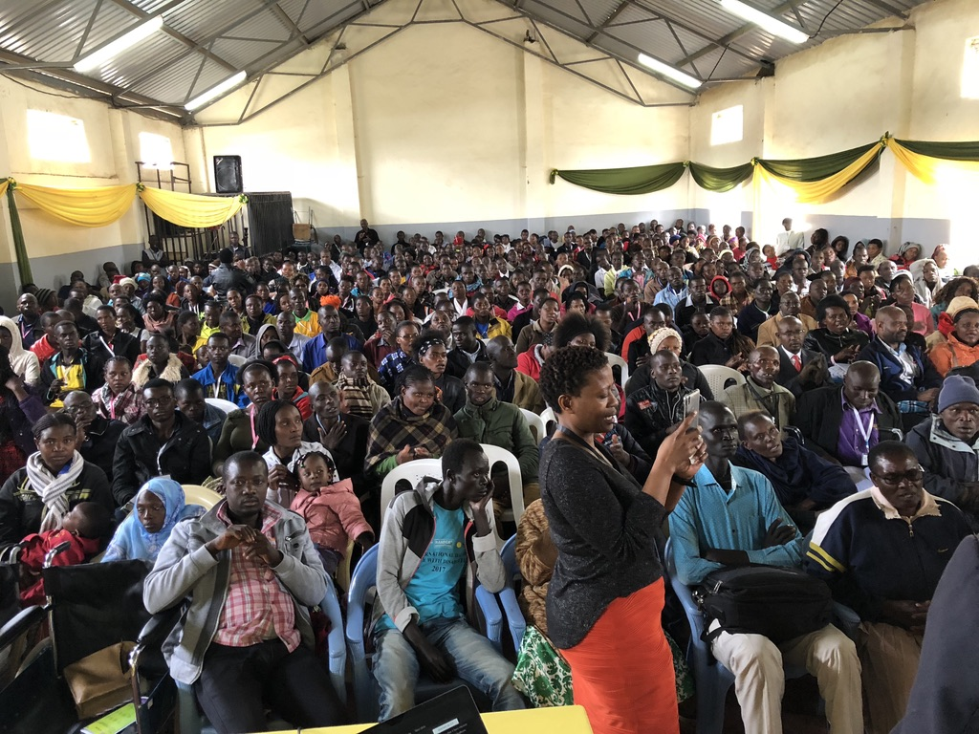
Just a few years ago(2011)
there were about 40-50 at our first meeting in
Kenya. The attendance
shown here is during the week.
There was an overflow
sitting outside as well.

Slide 6
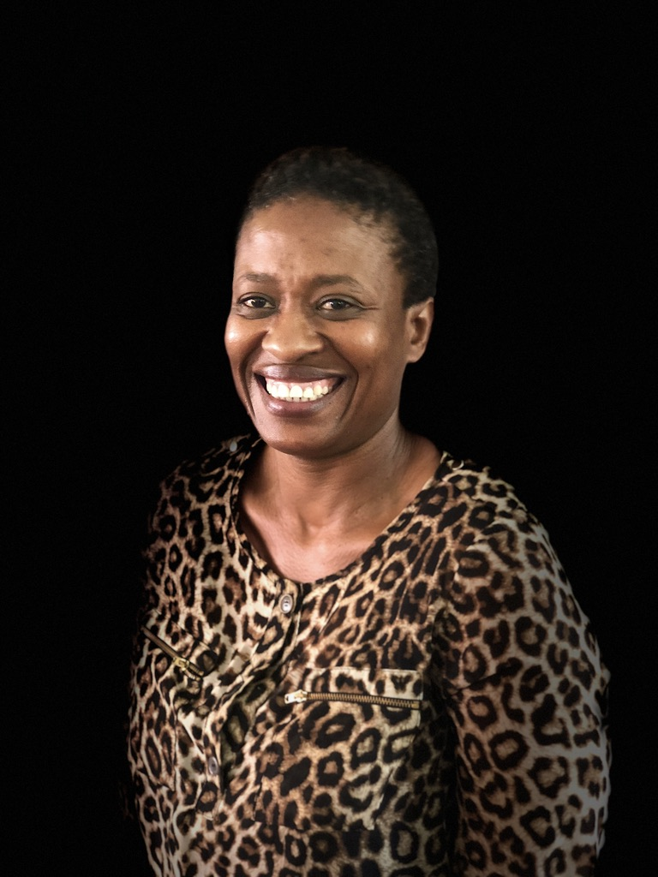
Zee Lekgwara, a committed
lay leader and interpreter for
the Deaf from
South Africa

Slide 7
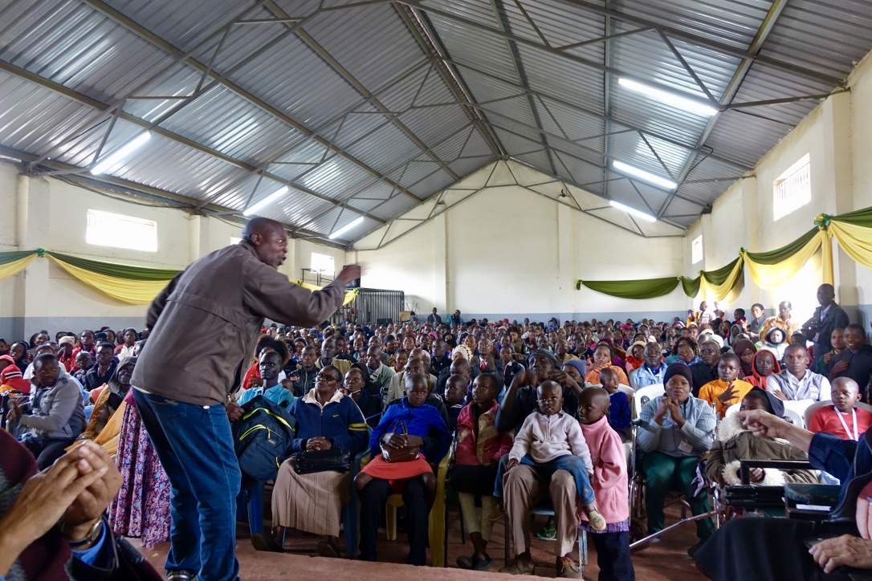
When Douglas
Mapeta leads a song service,
no one can
escape the
pull of his
enthusiasm.

Slide 8
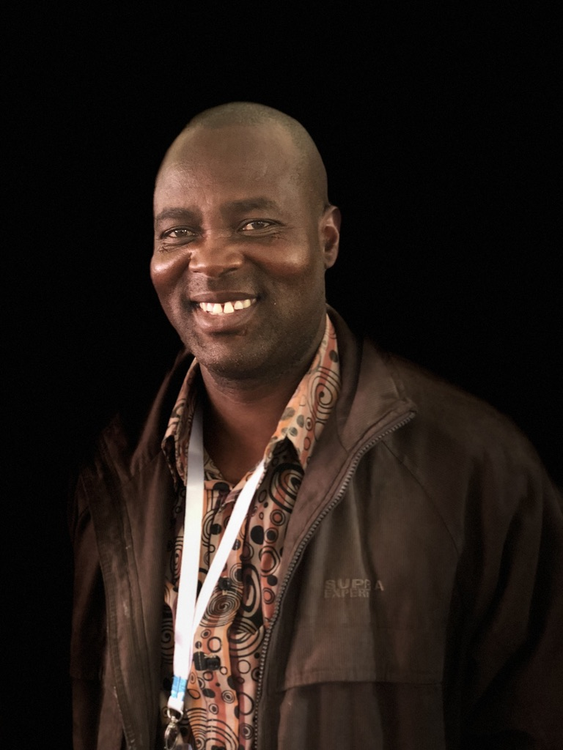
Doug Mapeta from
Zimbabwe.

Slide 9
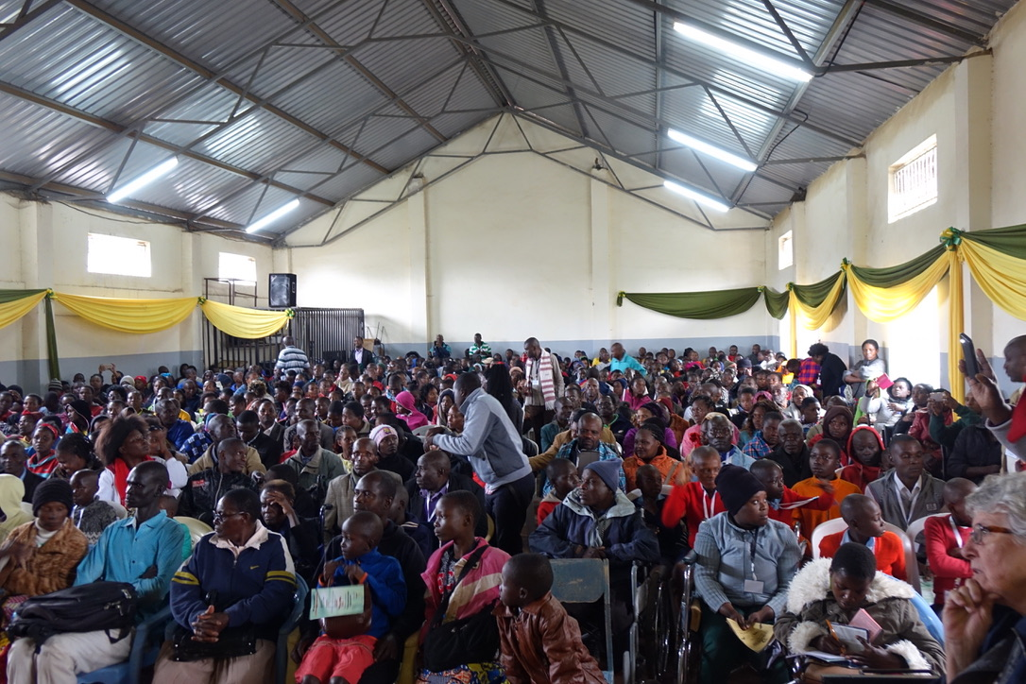
While there
were many
Deaf in attendance,
there were also many blind and
those with
a variety of
physical challenges.

Slide 10
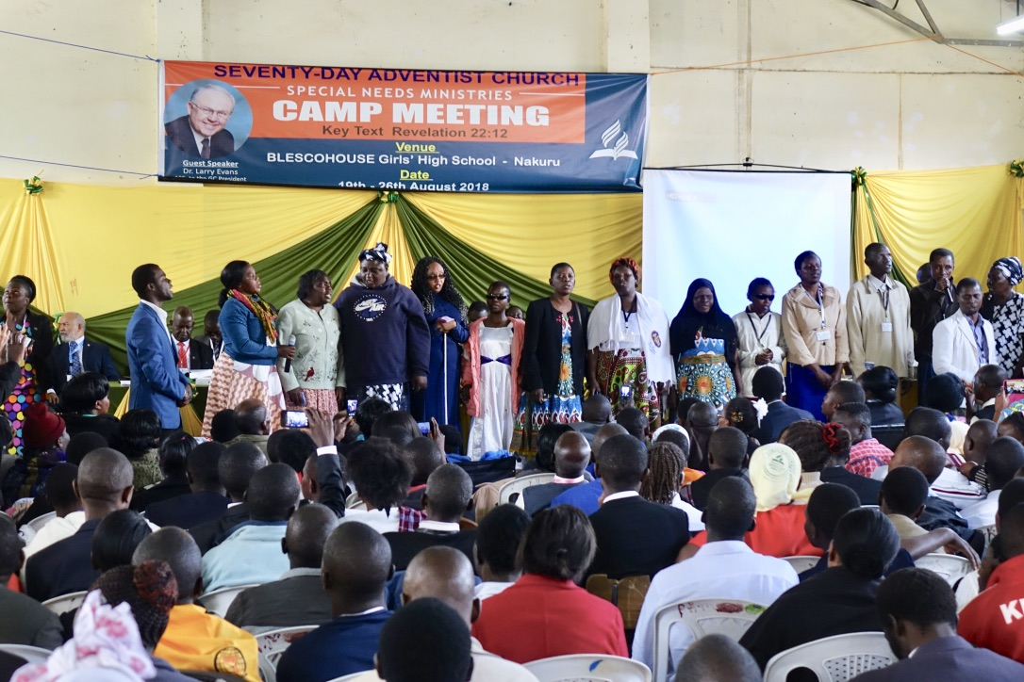
The blind also
have a song to share!!

Slide 11
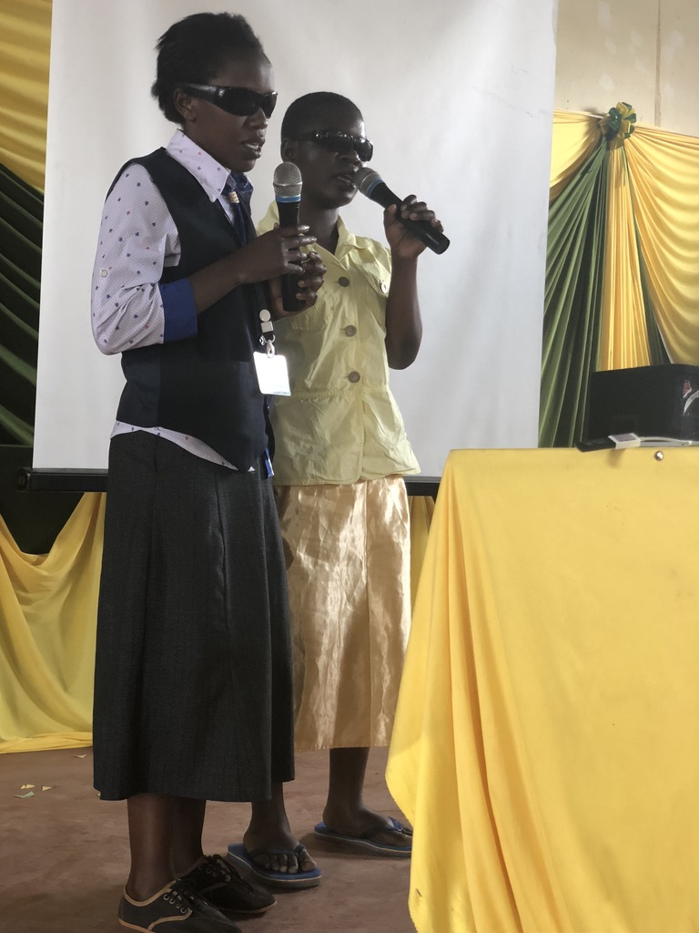
A duet sung by two blind
individuals.
What an encouragement
to hear them sing of their
faith in Jesus.

Slide 12
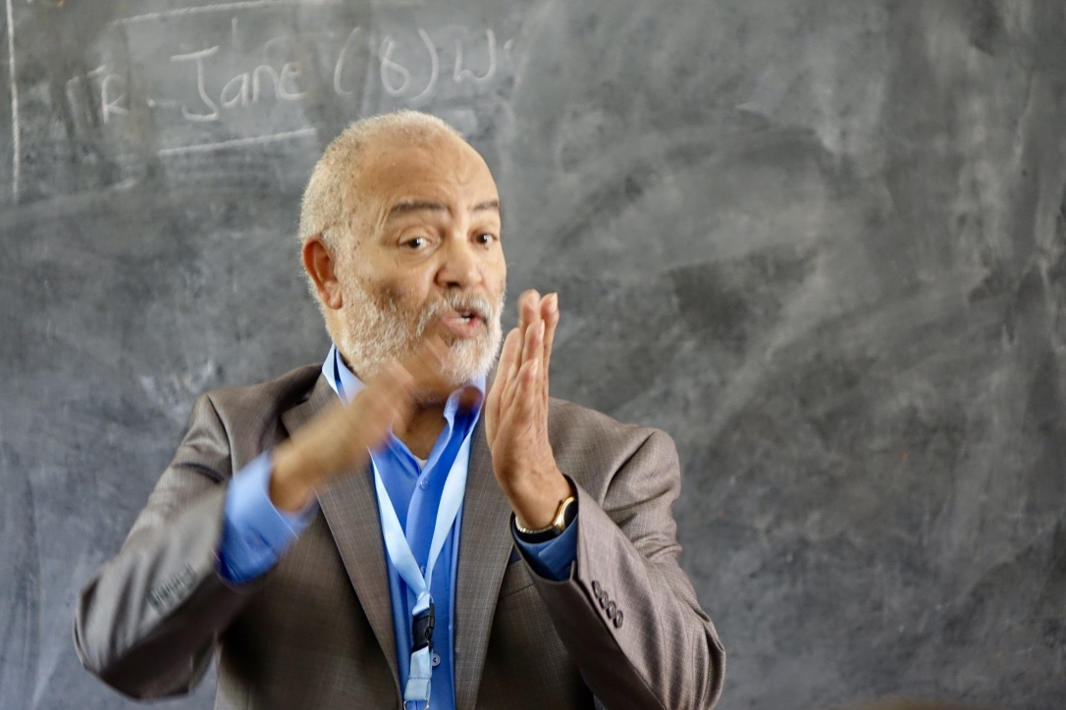
Thompson Kay, one very enthusiastic
interpreter for the Deaf!

Slide 13
Pastor John Blake and I
each had a growing
conviction that the taskforce workers for the Deaf in all 3 African division needed additional training. Gospel Outreach and the GC Special Needs Ministries paid for the transportation while the divisions paid for food and lodging.

Slide 14
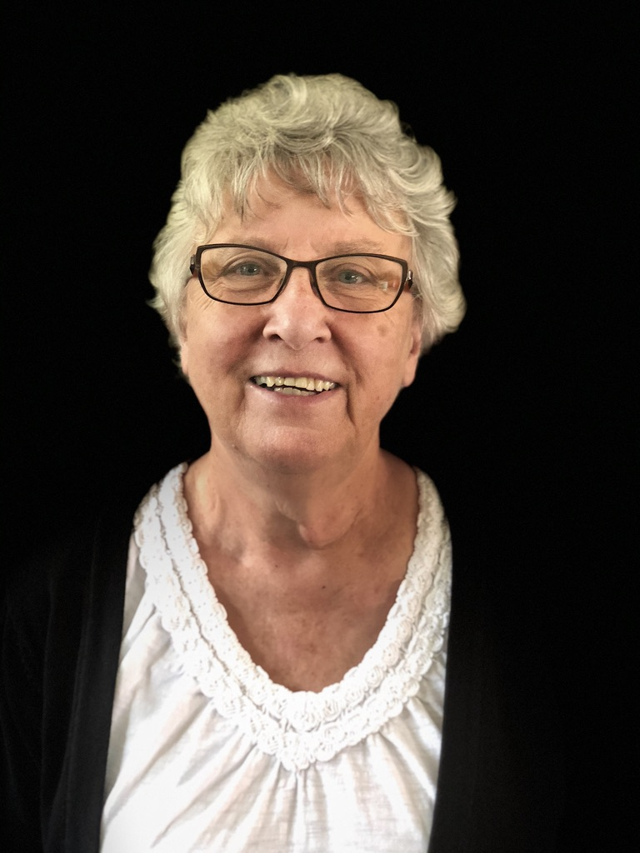
Pat Gustin was invited to do the training. She, a retired missionary and former professor of missions at Andrews University, provided the teaching. Her theme was how to read and teach from a relational approach and study of the Bible.

Slide 15
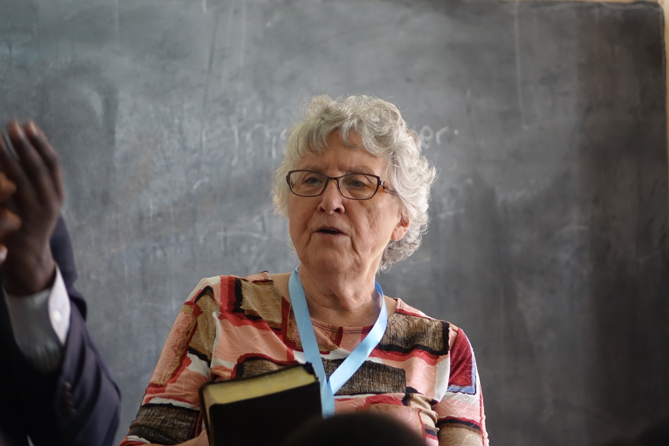

Slide 16
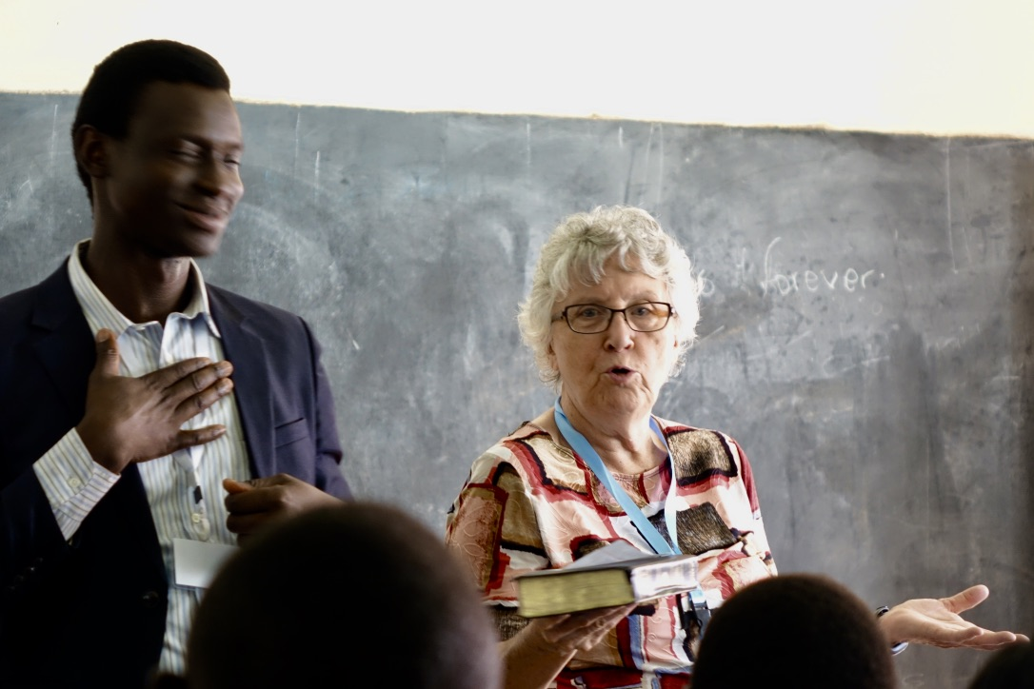

Slide 17
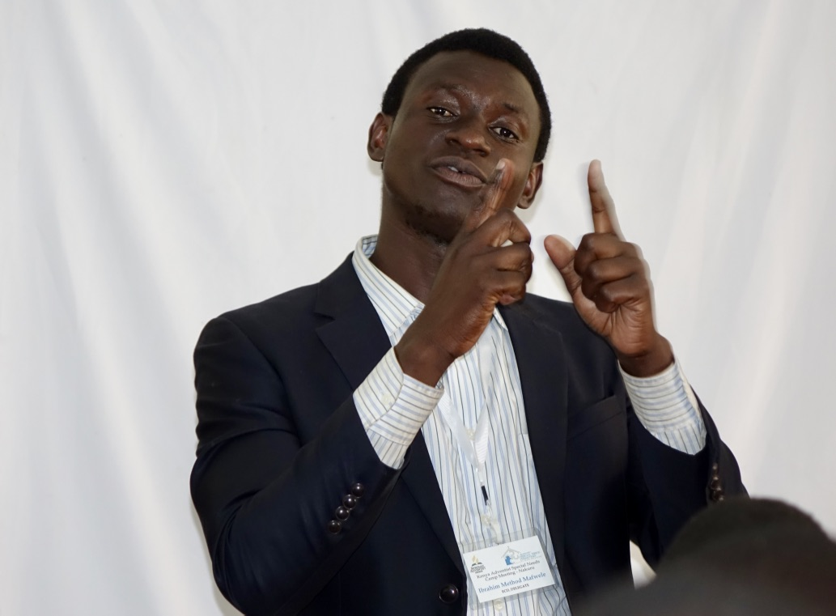
One of several
interpreters for
the different
sign languages
needed during the class.

Slide 18
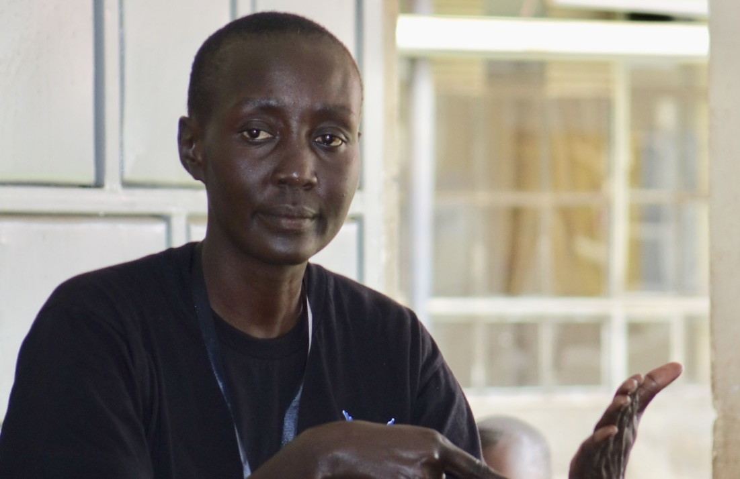
Another
interpreter.

Slide 19
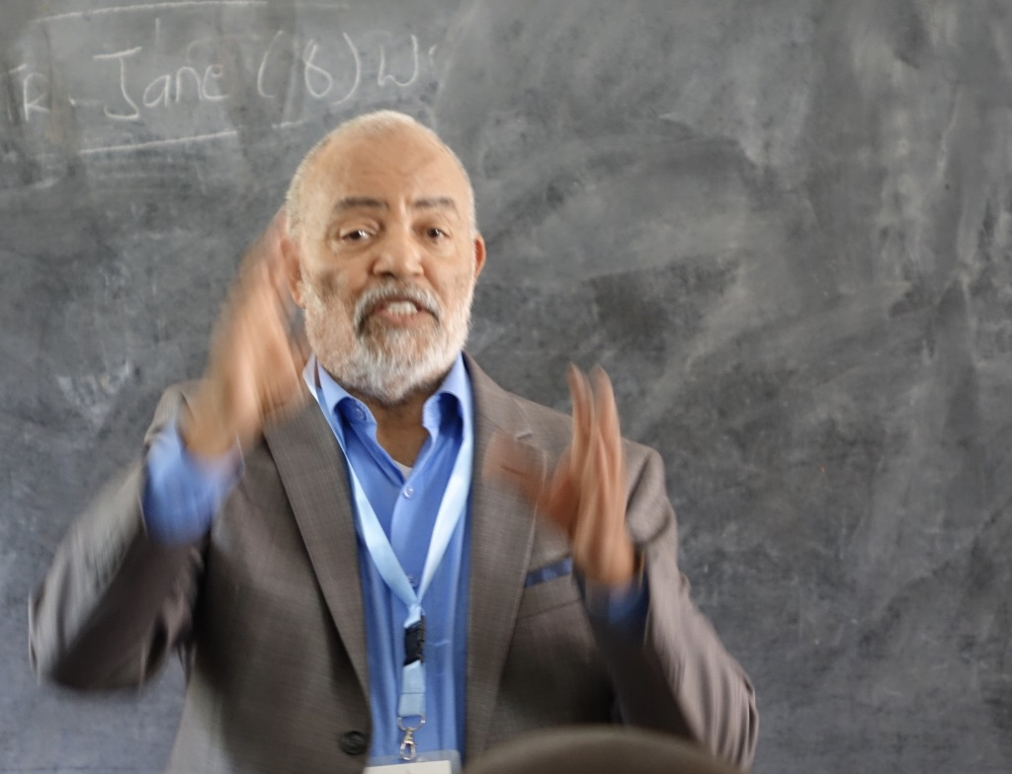

Slide 20
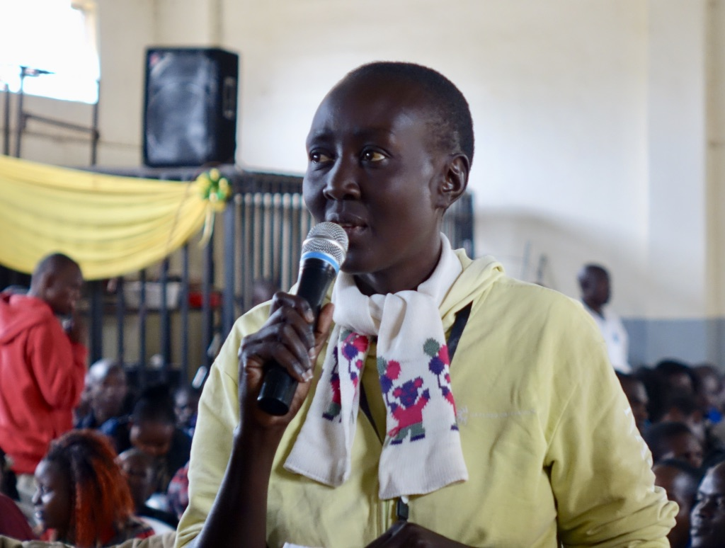
Class participation
was important.

Slide 21
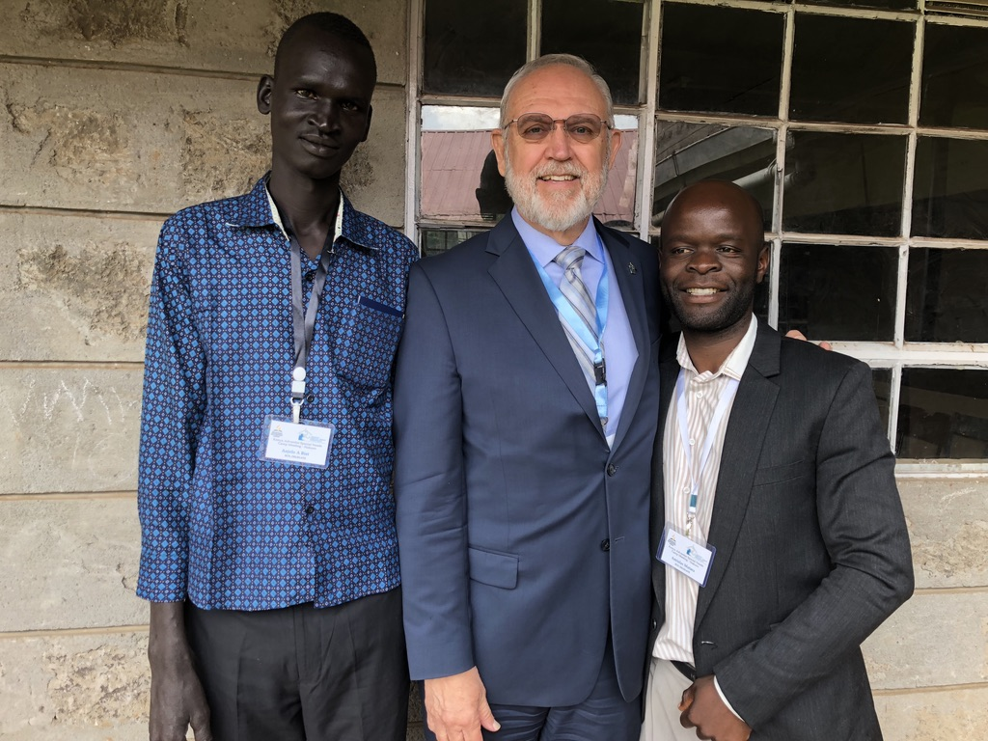
Suddenly I felt short, standing next to a worker from Sudan!

Slide 22
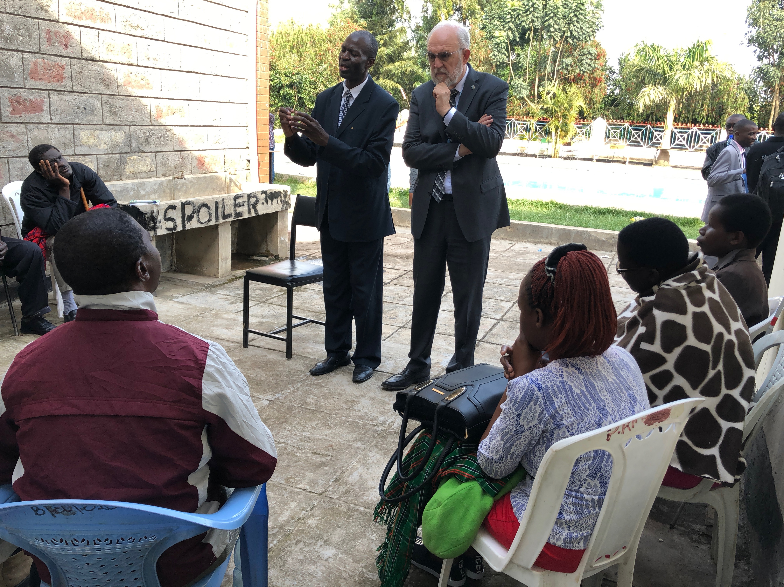
An amazing
opportunity to listen
to the concerns of
the blind!

Slide 23
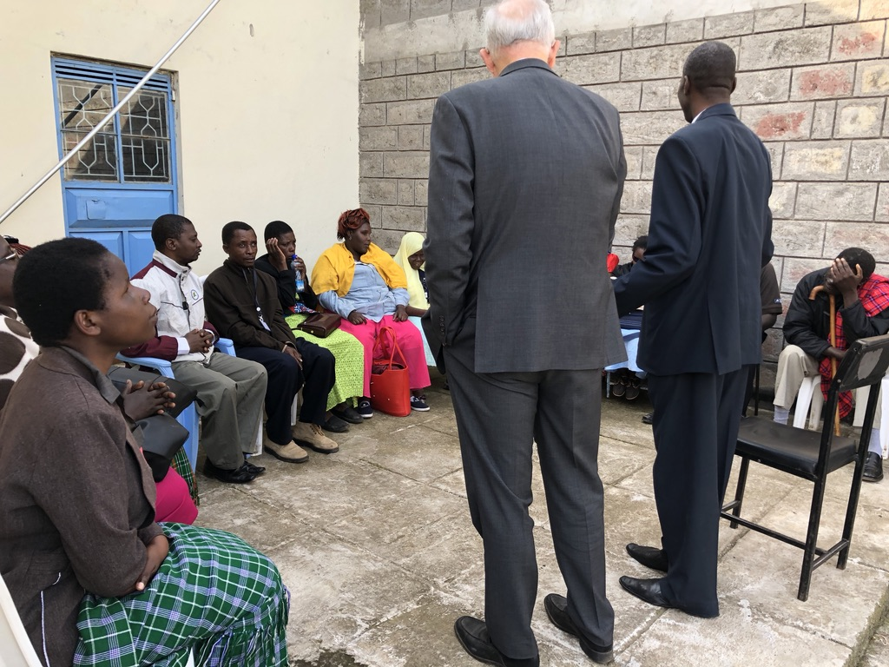
Is 35:5-6.
“The blind will see, the deaf will hear, the lame will walk & the mute will shout for joy.”

Slide 24
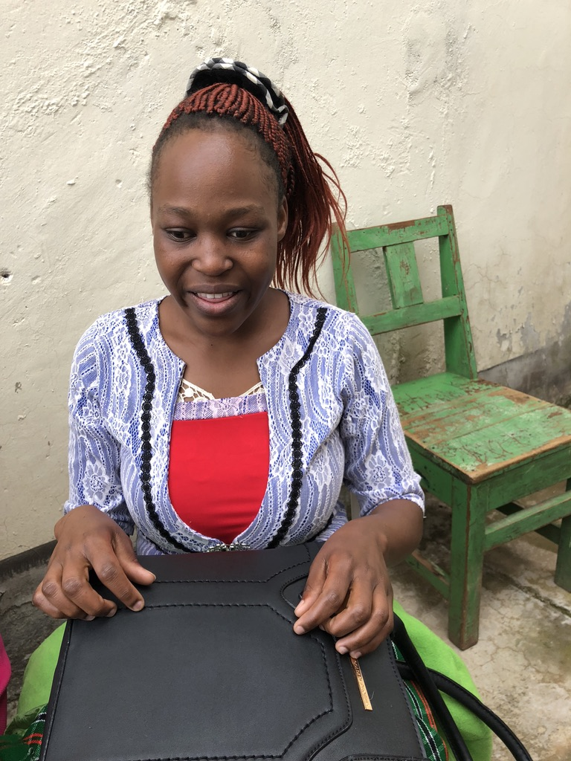
This blind lady works (I believe) as a court clerk.

Slide 25
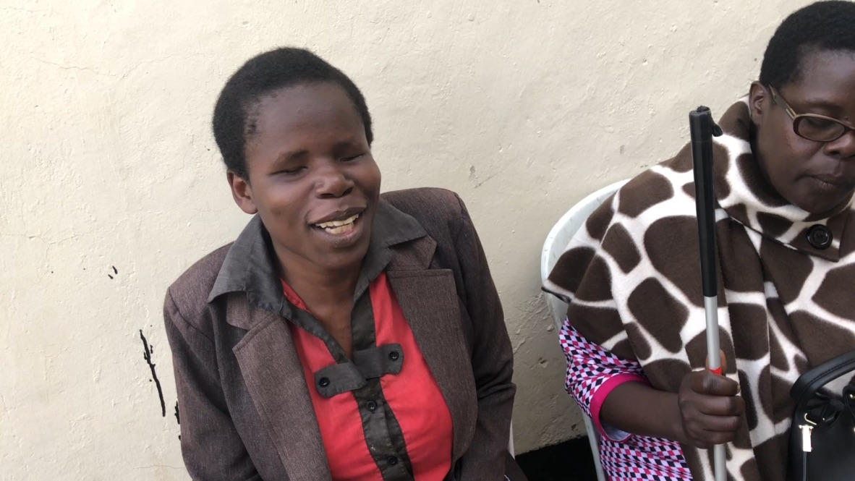

Slide 26
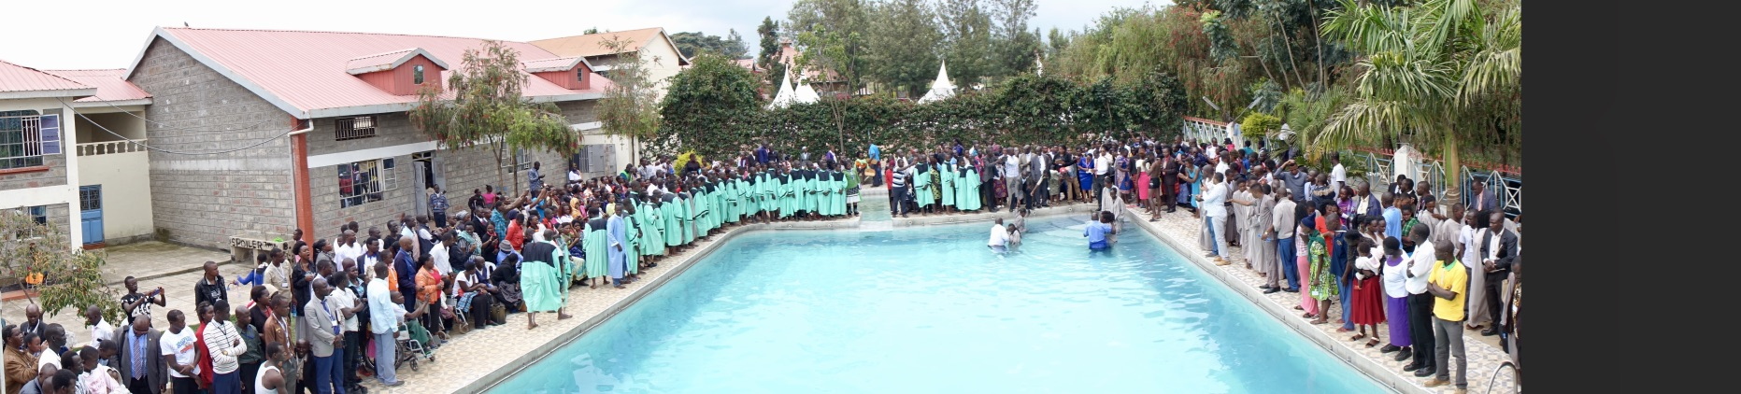
80 with a variety of “special needs” were baptized.

Slide 27
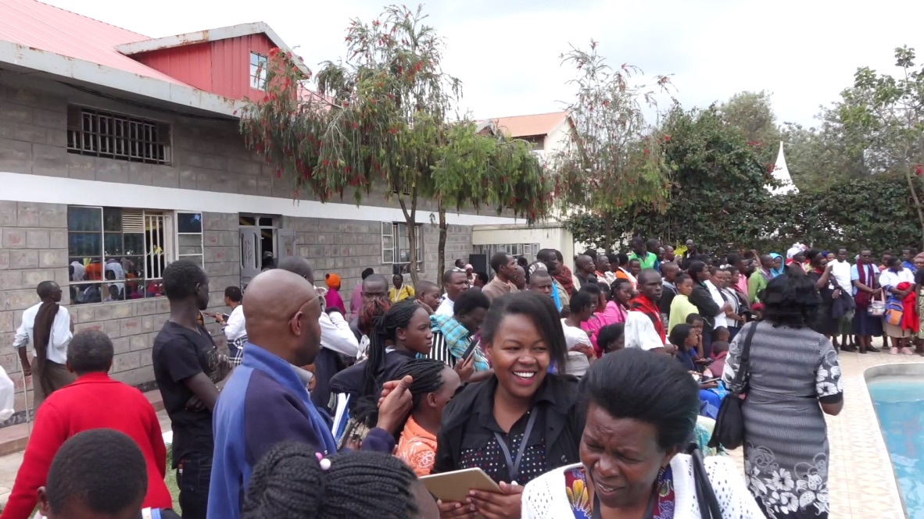

Slide 28
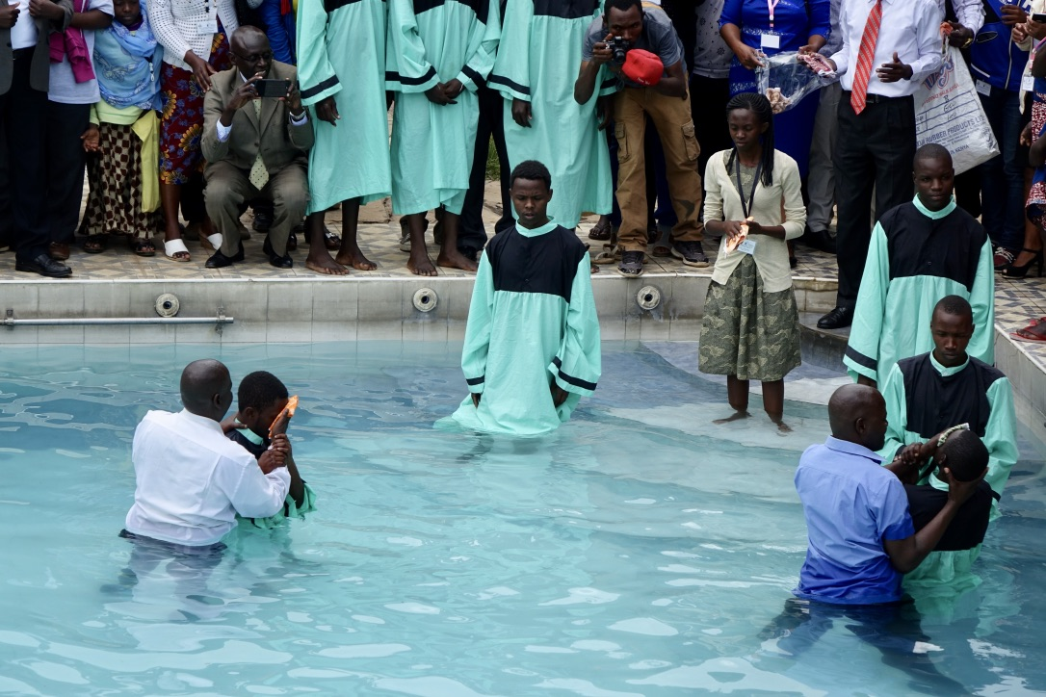

Slide 29
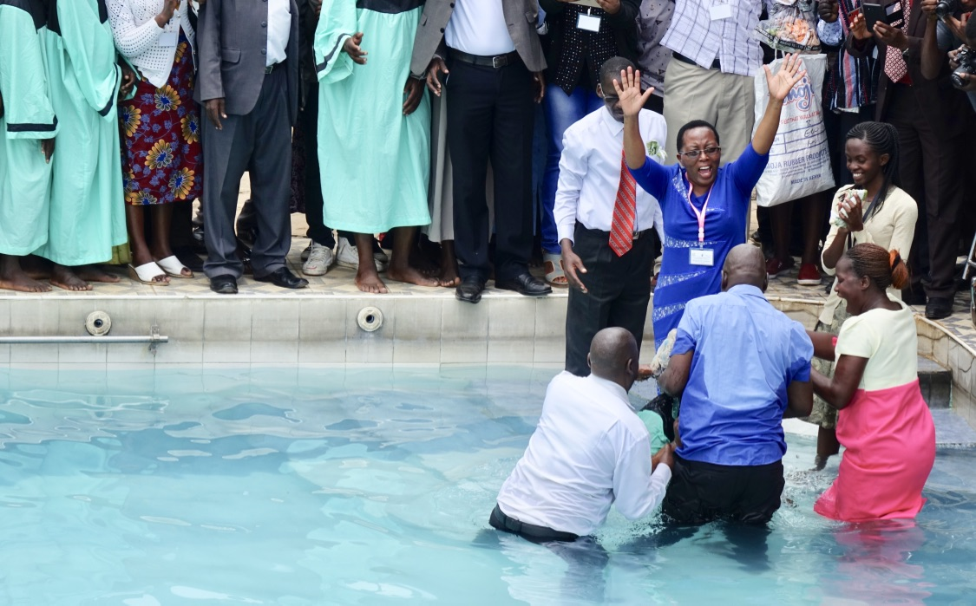

Slide 30
But they have
been here
all along. . . .
Finally we are
are beginning
see some things
differently and
some people
differently too.

Slide 31
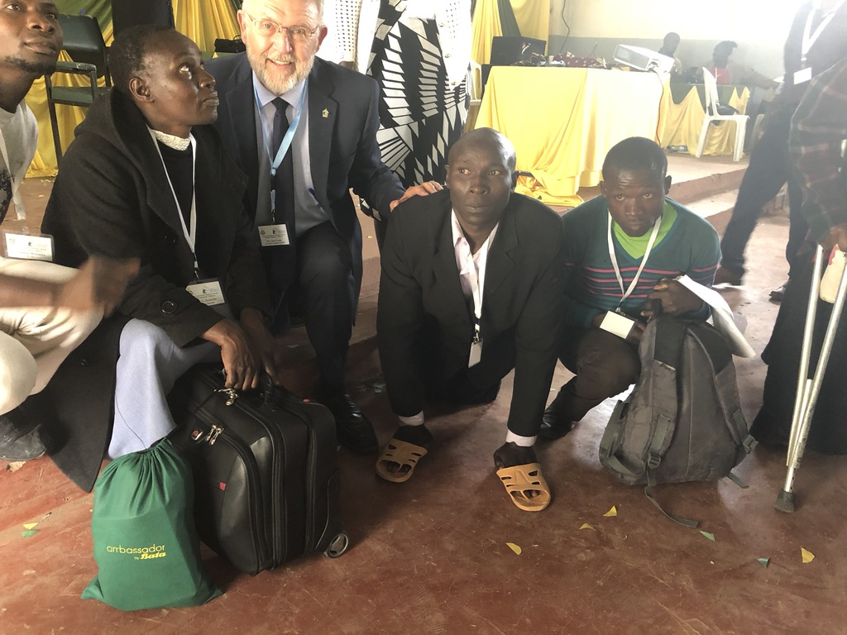
There is a reason why the man to my left has his shoes on his hands! He cannot stand or use his legs.

Slide 32
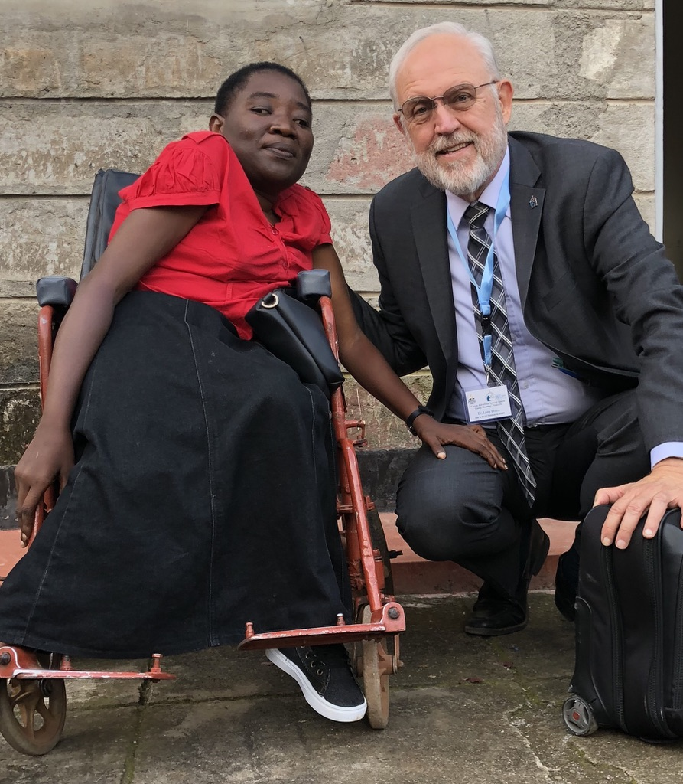
Her request was simple:
“Could I have a newer
wheelchair?”
The picture doesn’t
show it but it is an
“ancient” wheelchair.

Slide 33
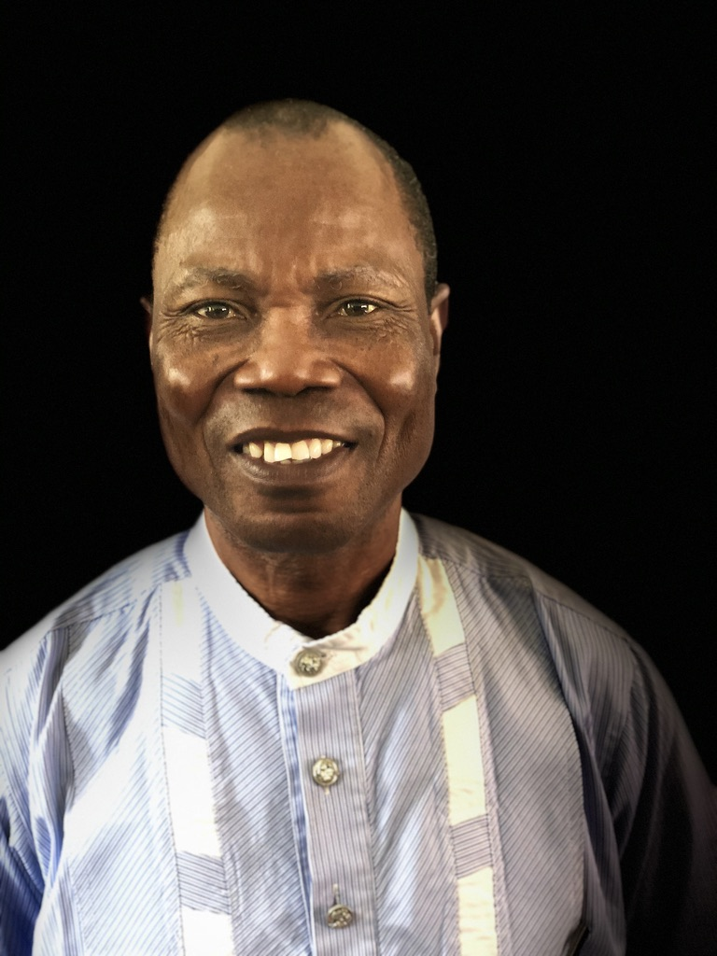
Solomon Nwaejike, a Special Needs
visionary from Nigeria!

Slide 34
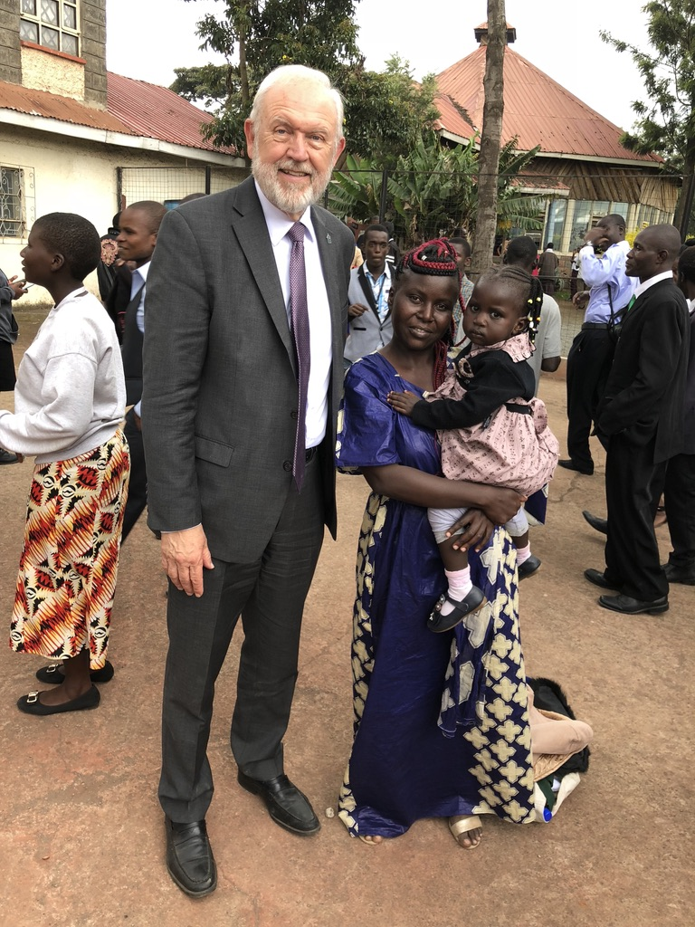
I first met this lady in 2013 at her wedding. It was one of the first weddings of deaf persons I ever attended. She visited the Special Needs Camp Meeting.

Slide 35
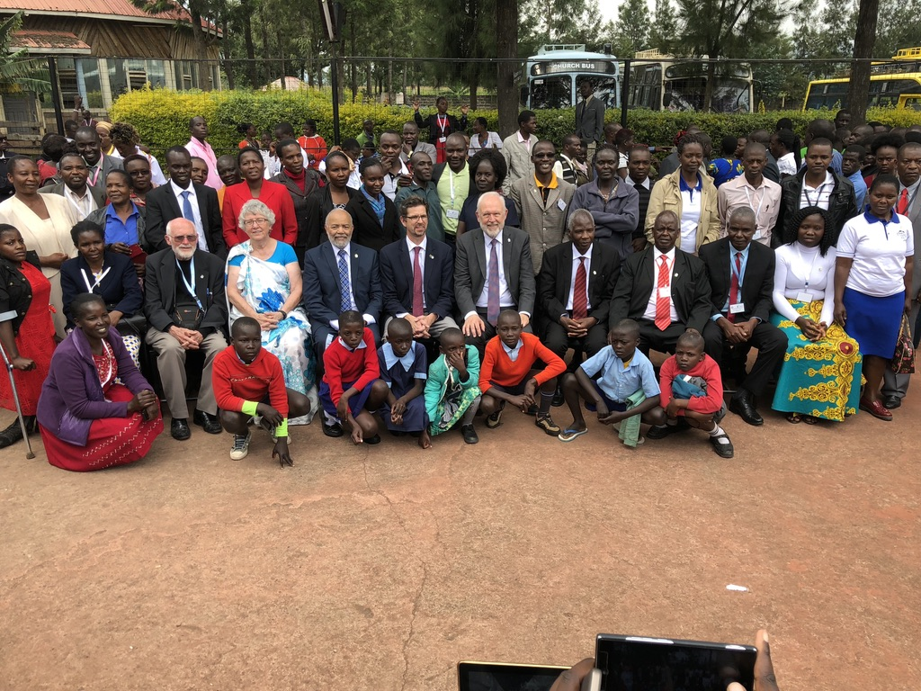
One of many group photos taken before we could say, “Good-bye.”

