Slide 1


Slide 2
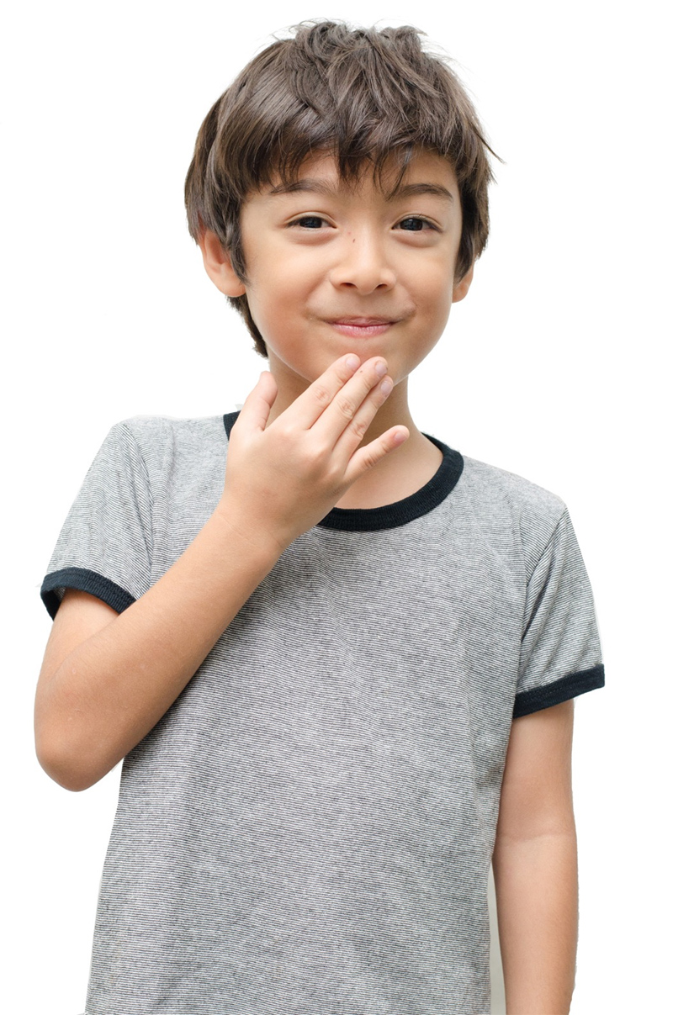

Songs

Slide 3
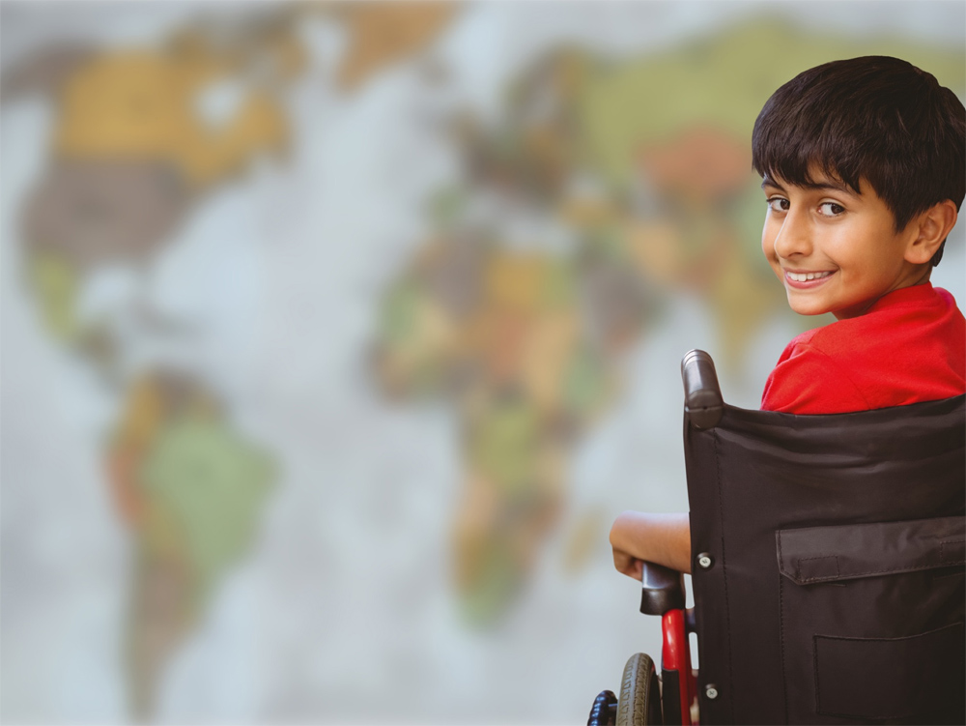
Lord of all nations
1
Lord of all nations, grant me grace
To love all people, every race,
And in each person may I see
My kindred loved, redeemed by Thee.

Slide 4
Lord of all nations
2
Break down the wall that would divide
Thy children, Lord, on every side.
My neighbor’s good let me pursue;
Let Christian love bind warm and true.

Slide 5
Lord of all nations
3
Forgive me, Lord, where I have erred
By loveless act and thoughtless word.
Make me to see the wrong I do
Will crucify my Lord anew.

Slide 6
Lord of all nations
4
Give me Thy courage, Lord, to speak
Whenever strong oppress the weak.
Should I myself the victim be,
Help me forgive, remembering Thee.

Slide 7
Lord of all nations
5
With Thine own love may I be filled
And by Thy Holy Spirit willed,
That all I touch, where’er I be,
May be divinely touched by Thee.

Slide 8
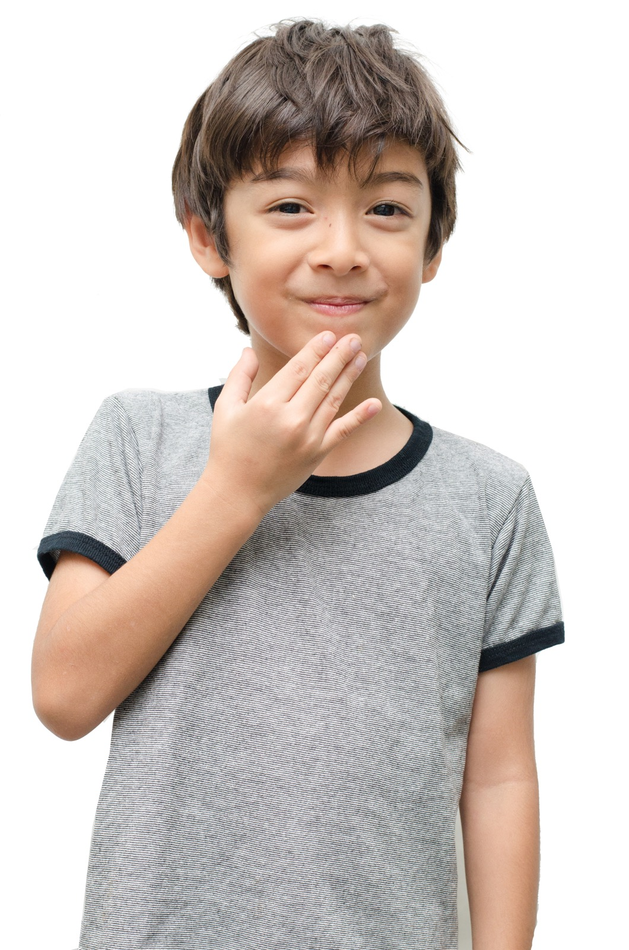
Prayer

Slide 9
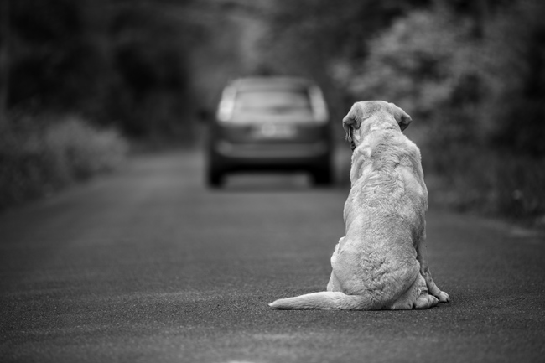
When Alone - Isolation mode

Slide 10
9Two are better than one,
because they have a good return for their labor:
10If either of them falls down,
one can help the other up.
But pity anyone who falls
and has no one to help them up.
11Also, if two lie down together, they will keep warm.
But how can one keep warm alone?
12Though one may be overpowered,
two can defend themselves.
A cord of three strands is not quickly broken. Ecclesiastes 4

Slide 11

Isolation Mode
The lesson

Slide 13
Songs

Slide 14
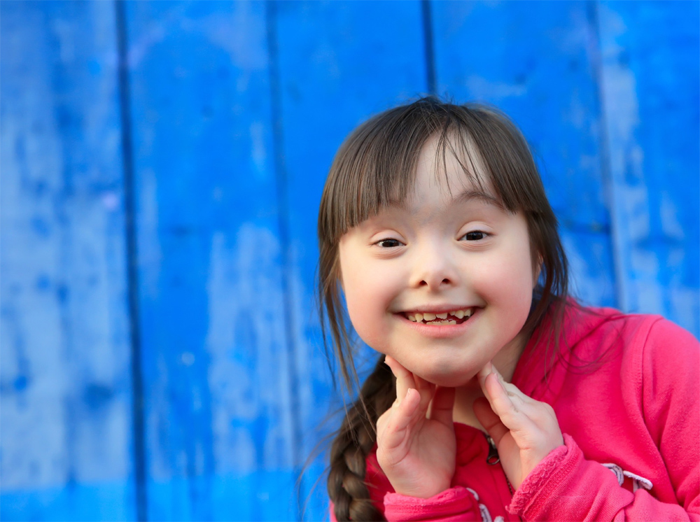
What a friend we have in Jesus
1
What a friend we have in Jesus,
all our sins and griefs to bear!
What a privilege to carry
everything to God in prayer!
O what peace we often forfeit,
O what needless pain we bear,
all because we do not carry
everything to God in prayer.

Slide 15
What a friend we have in Jesus
2
Have we trials and temptations?
Is there trouble anywhere?
We should never be discouraged;
take it to the Lord in prayer.
Can we find a friend so faithful
who will all our sorrows share?
Jesus knows our every weakness;
take it to the Lord in prayer.

Slide 16
What a friend we have in Jesus
3
Are we weak and heavy laden,
cumbered with a load of care?
Precious Savior, still our refuge;
take it to the Lord in prayer.
Do thy friends despise, forsake thee?
Take it to the Lord in prayer!
In his arms he'll take and shield thee;
thou wilt find a solace there.

Slide 17
Prayer

Slide 18
SNM Theme song : I’m not alone

